Slide 1


FR2214 - ENVIRONMENTAL, SOCIAL AND GOVERNANCE TOPICS IN BANKING AND FINANCE
MIKAEL HOMANEN

Slide 2
WHAT’S IMPORTANT TO YOU?

Slide 3
READINGS
REQUIRED:
  Slides and associated links to material.
  Schoenmaker, D., & Schramade, W. (2018). Principles of sustainable finance. Oxford University Press.
  De Haas, R. (2022). Sustainable Banking. CEPR Discussion Paper. link to the paper.
OPTIONAL:
  O'Connor, B. (2022). The ESG Investing Handbook: Insights and developments in environmental, social and governance investment. Harriman House Limited.
  Macpherson, M. and Ung, D. (2022). ESG Investing and Analysis - A Practitioner's Guide’. Risk Books.
  Searfeim, S. (2022). Purpose and Profit: How Business Can Lift Up the World. Harper Collins.
  Ditlev-Simonsen, C. (2022). A Guide to Sustainable Corporate Responsibility. From Theory to Action. Palgrave MacMillan

Slide 4





SUSTAINABLE CORPORATE GOALS

Slide 5
OVERVIEW
SDGs, Paris Goal, NZ, SBT
UNGP, OECD Guidelines, International Labor Standards
B Corporations, PRI, Impact Investing
GABV, Equator Principles, PRB

Slide 6

ESG - CONTEXT
Environmental, Social and Governance
Overarching term used in a variety of contexts
In short:
  Companies are assessed on their ESG performance.
  Investors use these assessments in their investment decision-making processes.
  Companies have ESG targets, but so do financial institutions. However, there are nuances to this. A climate target for a company is very different from a financial institution. Please bear these differences in mind as you try and understand the impact of an initiative on a company versus an investor.

Slide 7
ESG - CONTEXT
In the next few lessons, we will discuss corporate goals and corporate reporting. Keep in mind:
  In some cases, they may overlap. For example, Net Zero initiatives enable organizations to signal their commitments to the market, but they may also require reporting as well
  In some cases, initiatives may transition from voluntary to mandatory regulation. For example, TCFD has been adopted in regulation in certain jurisdictions
  The majority of frameworks do not clearly distinguish the difference between corporate expectations and investor expectations. Keep this in mind as you try and understand the purpose of each initiative and framework
  Lastly, certain frameworks have a i) focus ii) are designed or iii) have a higher adoption rate by certain types of institutions, e.g. publicly listed companies versus private companies.

Slide 8


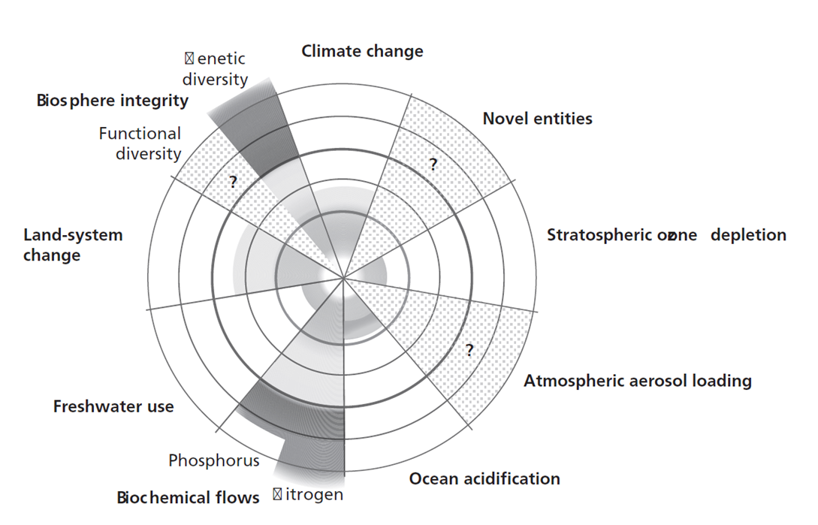

MOTIVATION:
PLANETARY
BOUNDARIES

Slide 9
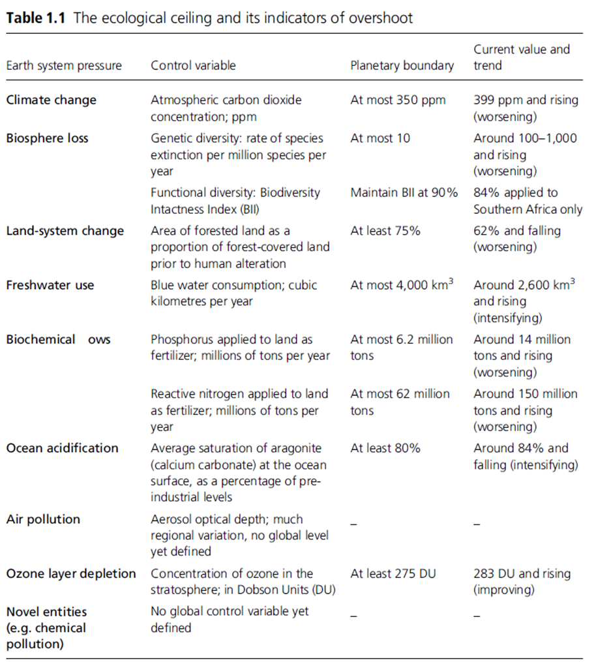
MOTIVATION:
ECOLOGICAL CEILING AND ITS INDICATORS FOR OVERSHOOT

Slide 10
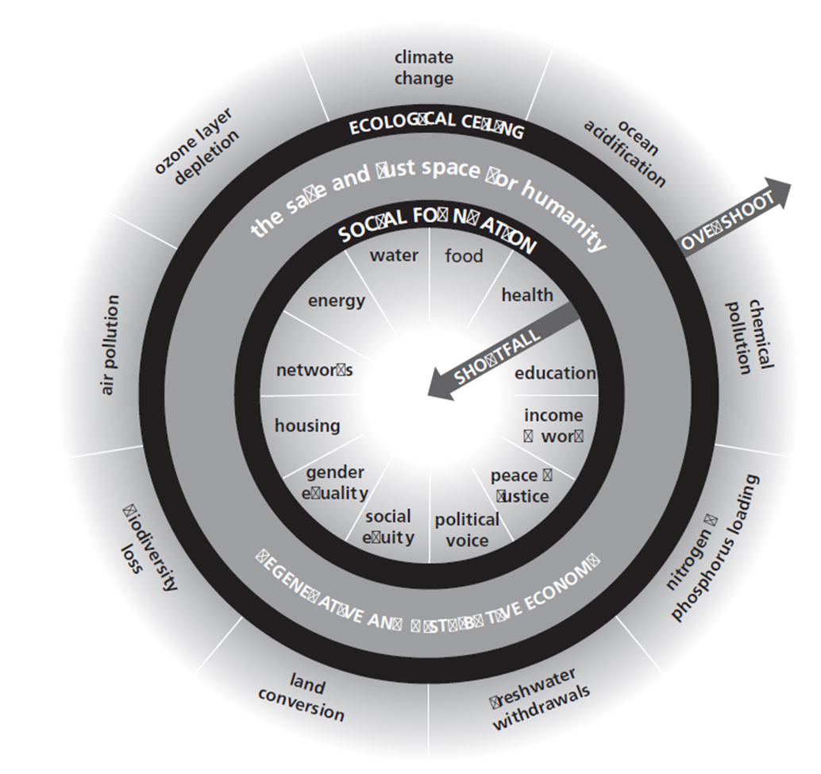
MOTIVATION:
SAFE AND JUST SPACE FOR HUMANITY

Slide 11
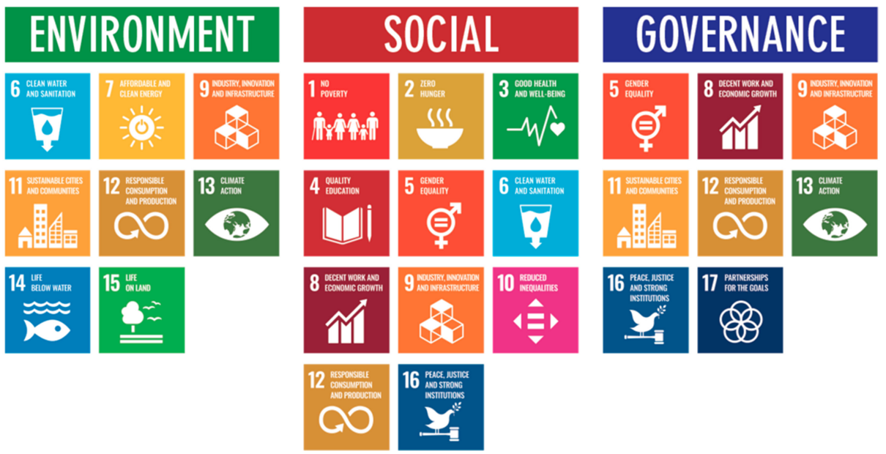
SDGS – SUSTAINABLE DEVELOPMENT GOALS
  The 2030 Agenda for Sustainable Development, adopted by all United Nations Member States in 2015, provides a shared blueprint for peace and prosperity for people and the planet, now and into the future. There are a total of 17 SDGs.
Link: https://sdgs.un.org/goals

Slide 12

PARIS GOALS
The Paris Agreement is a legally binding international treaty on climate change. It was adopted by 196 Parties at the UN Climate Change Conference (COP21) in Paris, France, on 12 December 2015. It entered into force on 4 November 2016.
Its overarching goal is to hold “the increase in the global average temperature to well below 2°C above pre-industrial levels” and pursue efforts “to limit the temperature increase to 1.5°C above pre-industrial levels.”
Case-Study
New research by the Transition Pathway Initiative finds that 29% of the largest publicly-listed industrial companies are set to align their emissions with the Paris Pledges by 2030, up from 24% in mid-2018. These companies are aligned with the emission reduction pledges made by national governments in the Paris Agreement. However, those pledges are not anticipated to keep global warming below dangerous levels, and the report finds that fewer than one in five companies (19%) are aligned with a pathway to keep global warming at 2°C or below.
Source: https://unfccc.int/news/most-high-emitting-industries-not-aligning-with-paris-goals#:~:text=More%20companies%20are%20setting%20long,14%20companies%20have%20done%20so.
Link: https://unfccc.int/process-and-meetings/the-paris-agreement#:~:text=Its%20overarching%20goal%20is%20to,above%20pre%2Dindustrial%20levels.%E2%80%9D

Slide 13
NZ – NET ZERO
What is net zero? Put simply, net zero means cutting greenhouse gas emissions to as close to zero as possible, with any remaining emissions re-absorbed from the atmosphere, by oceans and forests for instance.
Why is net zero important? The science shows clearly that in order to avert the worst impacts of climate change and preserve a livable planet, global temperature increase needs to be limited to 1.5°C above pre-industrial levels. Currently, the Earth is already about 1.1°C warmer than it was in the late 1800s, and emissions continue to rise. To keep global warming to no more than 1.5°C – as called for in the Paris Agreement – emissions need to be reduced by 45% by 2030 and reach net zero by 2050.
How can net zero be achieved? Transitioning to a net-zero world is one of the greatest challenges humankind has faced. It calls for nothing less than a complete transformation of how we produce, consume, and move about. The energy sector is the source of around three-quarters of greenhouse gas emissions today and holds the key to averting the worst effects of climate change. Replacing polluting coal, gas and oil-fired power with energy from renewable sources, such as wind or solar, would dramatically reduce carbon emissions.
Is there a global effort to reach net zero? Yes, a growing coalition of countries, cities, businesses and other institutions are pledging to get to net-zero emissions. More than 140 countries, including the biggest polluters – China, the United States, India and the European Union – have set a net-zero target, covering about 88% of global emissions. More than 9,000 companies, over 1000 cities, more than 1000 educational institutions, and over 600 financial institutions have joined the Race to Zero, pledging to take rigorous, immediate action to halve global emissions by 2030.

Slide 14

SBT – SCIENCE BASED TARGETS
Science-based targets provide companies with a clearly-defined path to reduce emissions in line with the Paris Agreement goals. More than 4,000 businesses around the world are already working with the Science Based Targets initiative
Setting a science-based target is a five-step process:
Commit: submit a letter establishing your intent to set a science-based target
Develop: work on an emissions reduction target in line with the SBTi’s criteria
Submit: present your target to the SBTi for official validation
Communicate: announce your target and inform your stakeholders
Disclose: report company-wide emissions and track target progress annually
Link: https://sciencebasedtargets.org/how-it-works

Slide 15
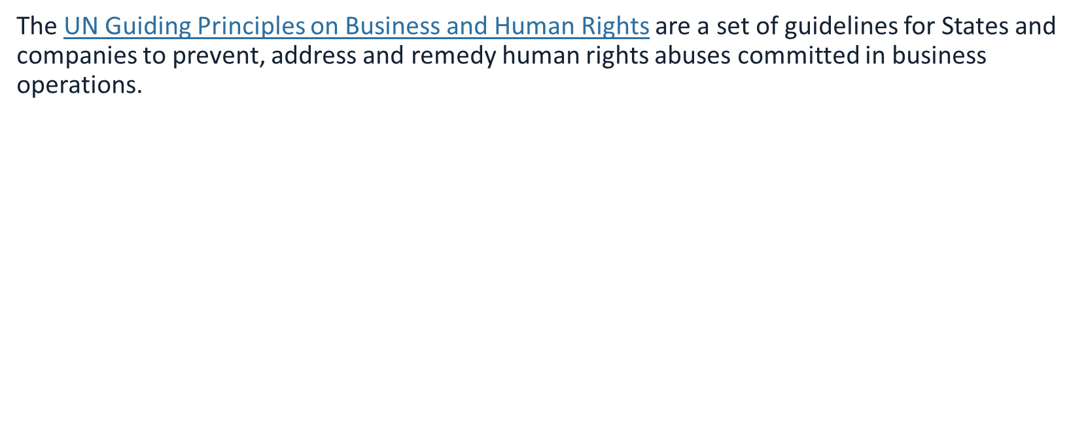
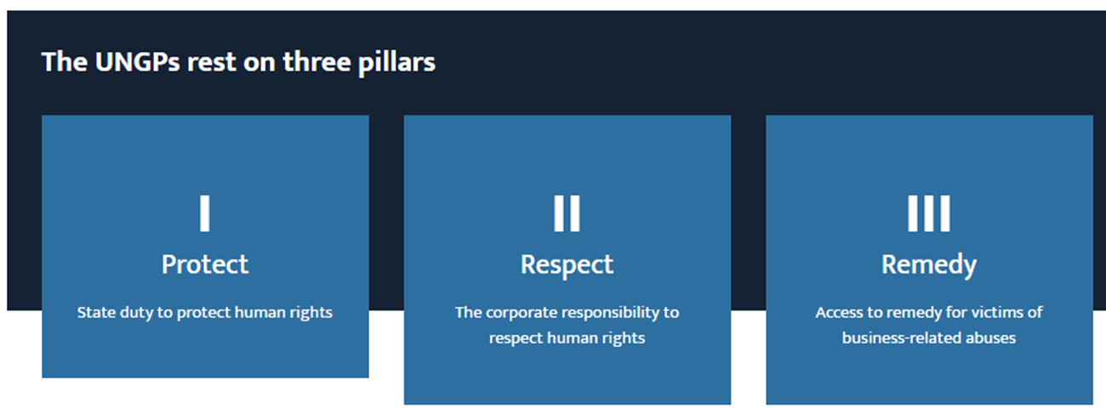
UNGPS – THE UN GUIDING PRINCIPLES OF BUSINESS AND HUMAN RIGHTS
Source: https://www.business-humanrights.org/en/big-issues/un-guiding-principles-on-business-human-rights/

Slide 16
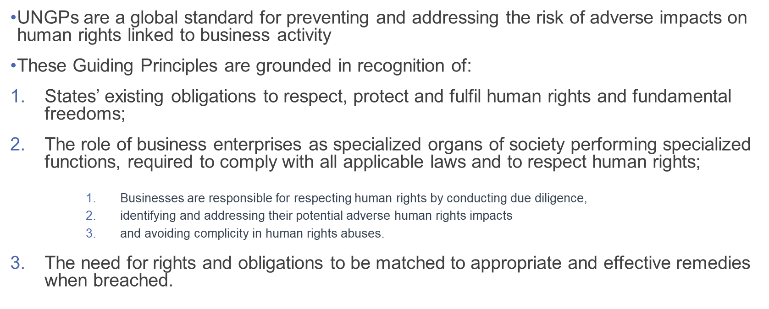
UNGPS – THE UN GUIDING PRINCIPLES OF BUSINESS AND HUMAN RIGHTS
Source: https://www.business-humanrights.org/en/big-issues/un-guiding-principles-on-business-human-rights/

Slide 17

OECD GUIDELINES FOR MULTINATIONAL ENTERPRISES ON RESPONSIBLE BUSINESS CONDUCT
  The OECD Guidelines for Multinational Enterprises on Responsible Business Conduct are recommendations addressed by governments to multinational enterprises.
  They aim to encourage positive contributions enterprises can make to economic, environmental and social progress, and to minimise adverse impacts on matters covered by the Guidelines that may be associated with an enterprise’s operations, products and services.
  The OECD Centre for Responsible Business Conduct uses RBC standards and recommendations to shape government policies and help businesses minimise the adverse impacts of their operations and supply chains, while providing a venue for the resolution of alleged corporate, social, environmental, labour or human rights abuses. Through RBC, businesses can make a positive contribution to economic growth and development and become a powerful driver for achieving the SDGs.
  Over 650 specific instances have been treated by country National Contact Points in over 100 countries and territories since 2000. https://mneguidelines.oecd.org/database/
Source: https://www.oecd.org/publications/oecd-guidelines-for-multinational-enterprises-on-responsible-business-conduct-81f92357-en.htm#:~:text=The%20Guidelines%20cover%20all%20key,technology%2C%20competition%2C%20and%20taxation

Slide 18
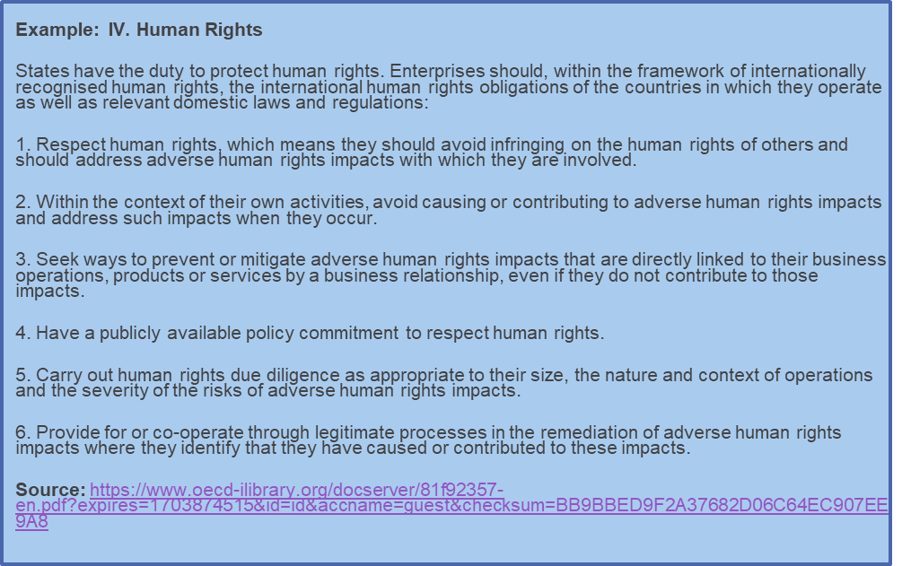
OECD GUIDELINES FOR MULTINATIONAL ENTERPRISES ON RESPONSIBLE BUSINESS CONDUCT
  The Guidelines cover all key areas of business responsibility, including human rights, labour rights, environment, bribery, consumer interests, disclosure, science and technology, competition, and taxation.
  The 2023 edition of the Guidelines provides updated recommendations for responsible business conduct across key areas, such as climate change, biodiversity, technology, business integrity and supply chain due diligence, as well as updated implementation procedures for the National Contact Points for Responsible Business Conduct.
Link: https://www.oecd.org/publications/oecd-guidelines-for-multinational-enterprises-on-responsible-business-conduct-81f92357-en.htm#:~:text=The%20Guidelines%20cover%20all%20key,technology%2C%20competition%2C%20and%20taxation.

Slide 19

DECLARATION OF THE INTERNATIONAL LABOR ORGANIZATION ON FUNDAMENTAL PRINCIPLES AND RIGHTS AT WORK
International labour standards are legal instruments drawn up by the ILO's constituents (governments, employers and workers) and setting out basic principles and rights at work. They are either Conventions (or Protocols), which are legally binding international treaties that may be ratified by member states, or Recommendations, which serve as non-binding guidelines. In many cases, a Convention lays down the basic principles to be implemented by ratifying countries, while a related Recommendation supplements the Convention by providing more detailed guidelines on how it could be applied. Recommendations can also be autonomous, i.e., not linked to a Convention.
The ILO Governing Body had initially identified eight “fundamental” Conventions, covering subjects that were considered to be fundamental principles and rights at work:
  freedom of association and the effective recognition of the right to collective bargaining
  the elimination of all forms of forced or compulsory labour
  the effective abolition of child labour
  and the elimination of discrimination in respect of employment and occupation.
Source: https://www.ilo.org/global/standards/introduction-to-international-labour-standards/conventions-and-recommendations/lang--en/index.htm

Slide 20
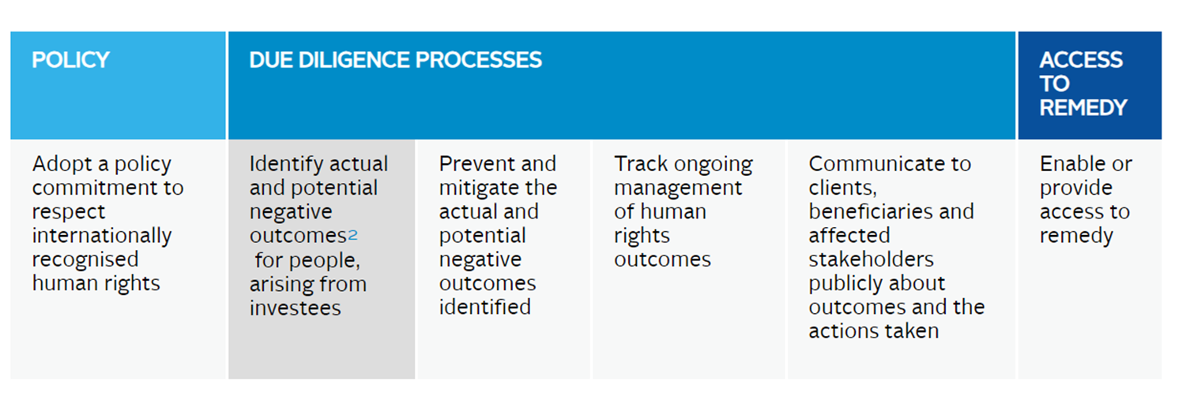
INVESTOR’S THREE-PART RESPONSIBILITY TO RESPECT HUMAN RIGHTS
As formalised by the UN and the OECD in 2011, institutional investors have a three-part responsibility to respect human rights (see case study from asset owner AP2 https://www.unpri.org/sustainable-development-goals/ap2-human-rights-/6048.article )
Source: https://www.unpri.org/human-rights/how-to-identify-human-rights-risks-a-practical-guide-in-due-diligence/11457.article

Slide 21
B - CORPORATIONS
  B Corp Certification is a designation that a business is meeting high standards of verified performance, accountability, and transparency on factors from employee benefits and charitable giving to supply chain practices and input materials. In order to achieve certification, a company must:
  Demonstrate high social and environmental performance by achieving a B Impact Assessment score of 80 or above and passing our risk review. Multinational corporations must also meet baseline requirement standards.
  Make a legal commitment by changing their corporate governance structure to be accountable to all stakeholders, not just shareholders, and achieve benefit corporation status if available in their jurisdiction.
  Exhibit transparency by allowing information about their performance measured against B Lab’s standards to be publicly available on their B Corp profile on B Lab’s website.
Note: A Benefit Corporation is a legal entity, which is different from a B Corp Certification.
Discussion: What do you think is the main benefit of achieving B corp versus C corp status?
Source: https://usca.bcorporation.net/benefit-corporation/
Source: https://www.bcorporation.net/en-us/certification/

Slide 22

PRI – PRINCIPLES FOR RESPONSIBLE INVESTMENT
Signatories’ commitment: “As institutional investors, we have a duty to act in the best long-term interests of our beneficiaries. In this fiduciary role, we believe that environmental, social, and corporate governance (ESG) issues can affect the performance of investment portfolios (to varying degrees across companies, sectors, regions, asset classes and through time). We also recognise that applying these Principles may better align investors with broader objectives of society. Therefore, where consistent with our fiduciary responsibilities, we commit to the following:
Principle 1: We will incorporate ESG issues into investment analysis and decision-making processes.
Principle 2: We will be active owners and incorporate ESG issues into our ownership policies and practices.
Principle 3: We will seek appropriate disclosure on ESG issues by the entities in which we invest.
Principle 4: We will promote acceptance and implementation of the Principles within the investment industry.
Principle 5: We will work together to enhance our effectiveness in implementing the Principles.
Principle 6: We will each report on our activities and progress towards implementing the Principles.
The Principles for Responsible Investment were developed by an international group of institutional investors reflecting the increasing relevance of environmental, social and corporate governance issues to investment practices. The process was convened by the United Nations Secretary-General. In signing the Principles, we as investors publicly commit to adopt and implement them, where consistent with our fiduciary responsibilities. We also commit to evaluate the effectiveness and improve the content of the Principles over time. We believe this will improve our ability to meet commitments to beneficiaries as well as better align our investment activities with the broader interests of society. We encourage other investors to adopt the Principles.”
Source: https://www.unpri.org/about-us/what-are-the-principles-for-responsible-investment

Slide 23
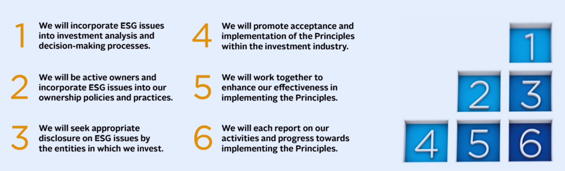
PRI PRINCIPLES

Slide 24
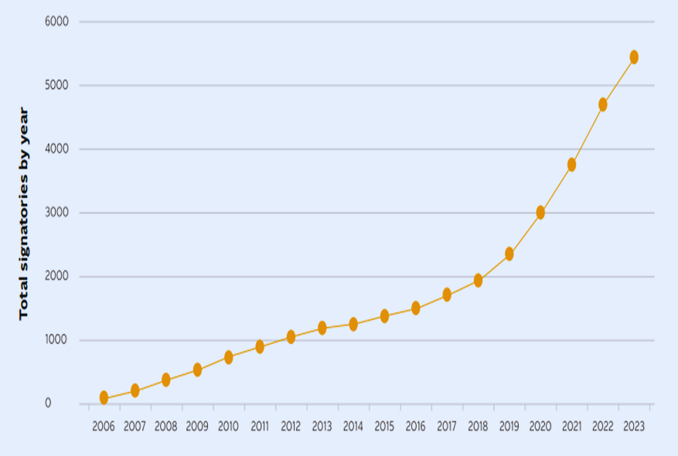
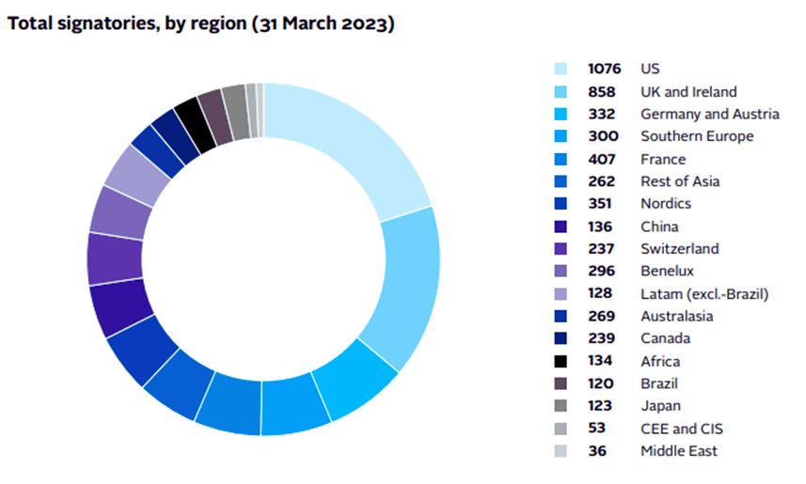
PRI SIGNATORIES
Source: https://www.unpri.org/annual-report-2023

Slide 25

IMPACT INVESTING
  Impact investing is a growing industry powered by investors who are determined to generate social and environmental impact as well as financial returns. This is taking place all over the world, and across all asset classes.
  Signatories to the (nine) Impact Principles are impact investors that publicly demonstrate their commitment to implementing a global standard for managing investments for impact.
  Global Impact Investment Network (GIIN) is one of the largest membership organizations for impact investors and their tool IRIS+ helps investors measure and communicate the impact of their investments.
Source: https://www.impactprinciples.org/signatories-reporting \

Slide 26
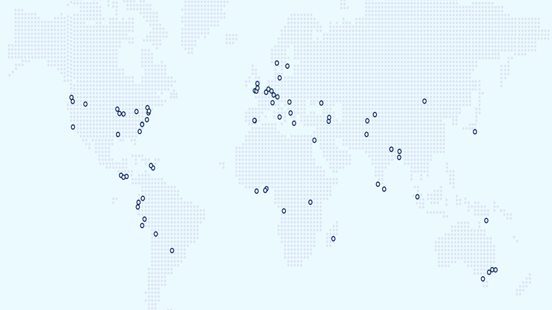
GABV – GLOBAL ALLIANCE FOR BANKING ON VALUES
  The Global Alliance for Banking on Values (GABV) provides a unique space of collaboration for leaders and practitioners in values-based banking to learn from each other, deliver targeted initiatives and advocate effectively for social and sustainable banking practices worldwide.
  This meant that in agreeing to be a member of the Alliance, each bank would live by these 6 principles: i) Triple Bottom Line Approach ii) Real Economy iii) Client-Centred iv) Long-Term Resiliency v) Transparency vi) Culture
Source: https://www.gabv.org/banking-on-values/

Slide 27

EQUATOR PRINCIPLES
  Large infrastructure and industrial Projects can have adverse impacts on people and on the environment. The Equator Principles (EP) are intended to serve as a common baseline and risk management framework for financial institutions to identify, assess and manage environmental and social risks when financing Projects.
  The EP apply globally, to all industry sectors and to five financial products including i) Project Finance Advisory Services ii) Project Finance iii) Project-Related Corporate Loans iv) Bridge Loans, and v) Project-Related Refinance, and Project-Related Acquisition Finance.
  Equator Principles Financial Institutions (EPFIs) implement the 10 EP through their internal environmental and social risk management policies, procedures and standards in order to comply with the EP. EPFIs may (at their own discretion) choose to utilise the EP for additional financial products outside the scope of the EP.
Source: https://equator-principles.com/about-the-equator-principles/

Slide 28
PRB – PRINCIPLES FOR RESPONSIBLE BANKING
  With over 330 signatory banks representing over half of the global banking industry, the Principles are the world’s foremost sustainable banking framework.
  Through the Principles, banks take action to align their core strategy, decision-making, lending and investment with the UN Sustainable Development Goals, and international agreements such as the Paris Climate Agreement.
  The Principles for Responsible Banking include the Net-Zero Banking Alliance, which is the climate-focused initiative of this global framework.
Link: https://www.unepfi.org/banking/bankingprinciples/

Slide 29
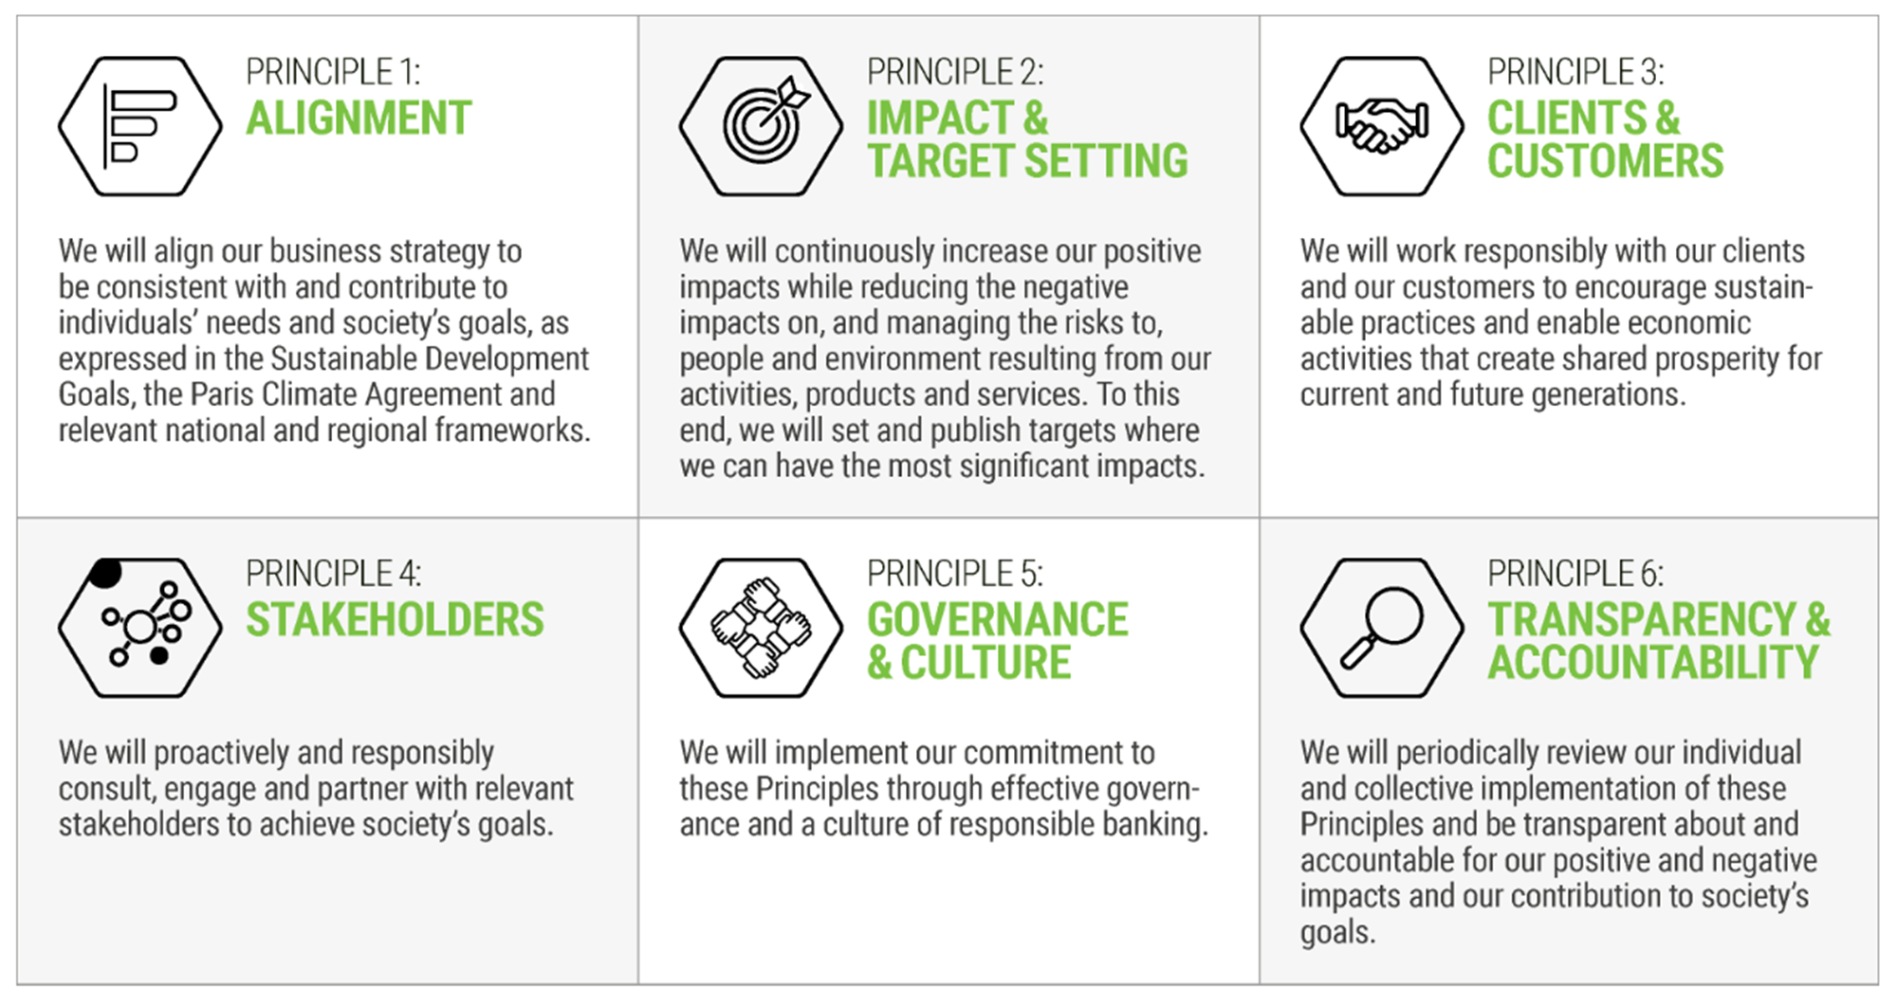

Slide 30
QUESTIONS

Slide 31
SUSTAINABLE REPORTING AND MEASUREMENT

Slide 32
OVERVIEW
TCFD and TNFD
GRI, CDP, IR, ISSB and GHG Protocol
ESG Fund Labels
ESG Measurement

Slide 33
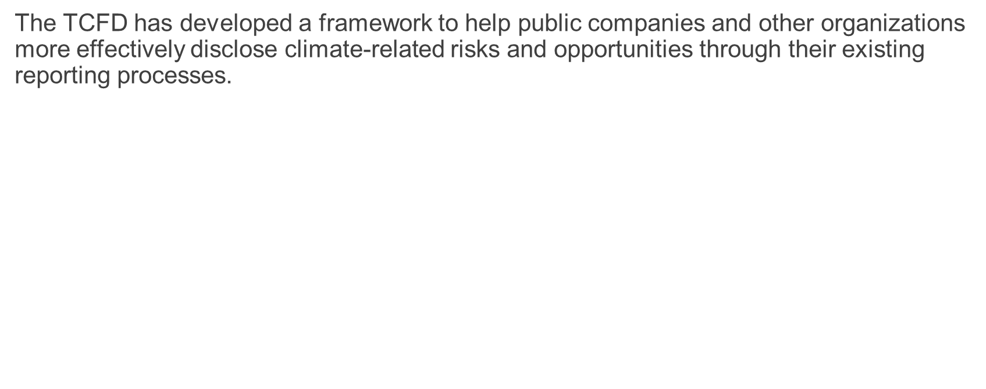
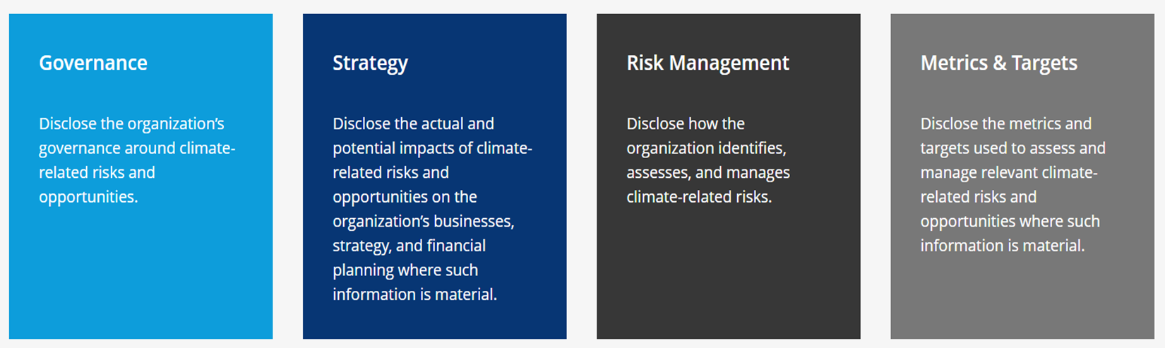
TCFD – TASK FORCE ON CLIMATE-RELATED FINANCIAL DISCLOSURES
Source: https://www.fsb-tcfd.org/

Slide 34
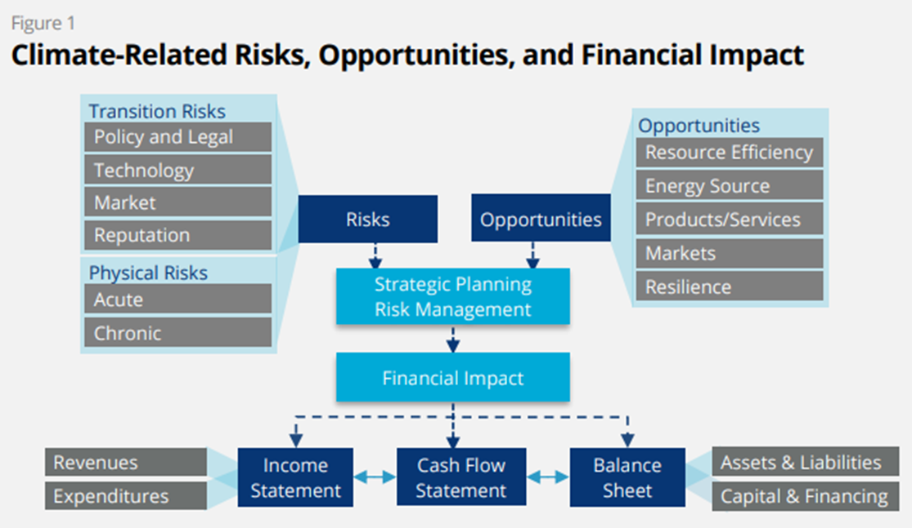
In order to make more informed financial decisions, investors, lenders, and insurance underwriters need to understand how climate-related risks and opportunities are likely to impact an organization’s future financial position as reflected in its income statement, cash flow statement, and balance sheet as outlined in Figure 1
Source: https://www.fsb-tcfd.org/recommendations/

Slide 35
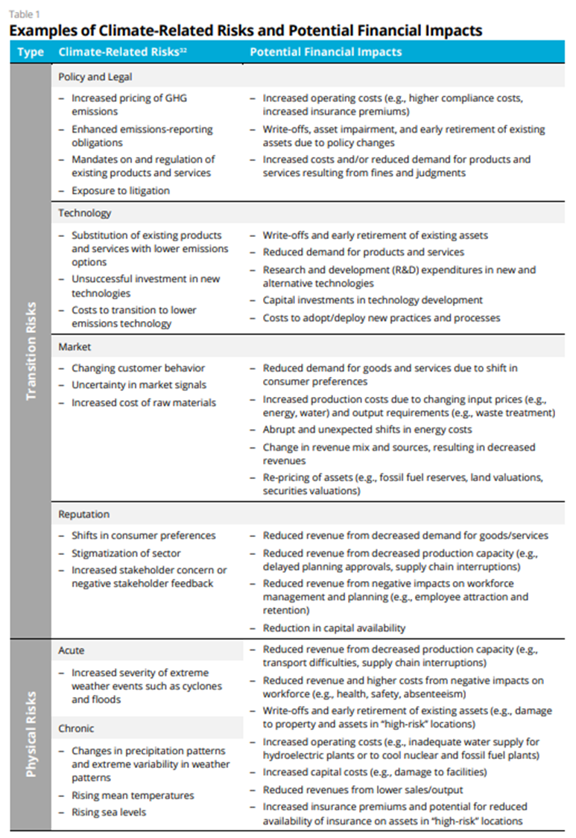
Examples of climate-related risks and their potential financial impacts
Source: https://www.fsb-tcfd.org/recommendations/

Slide 36
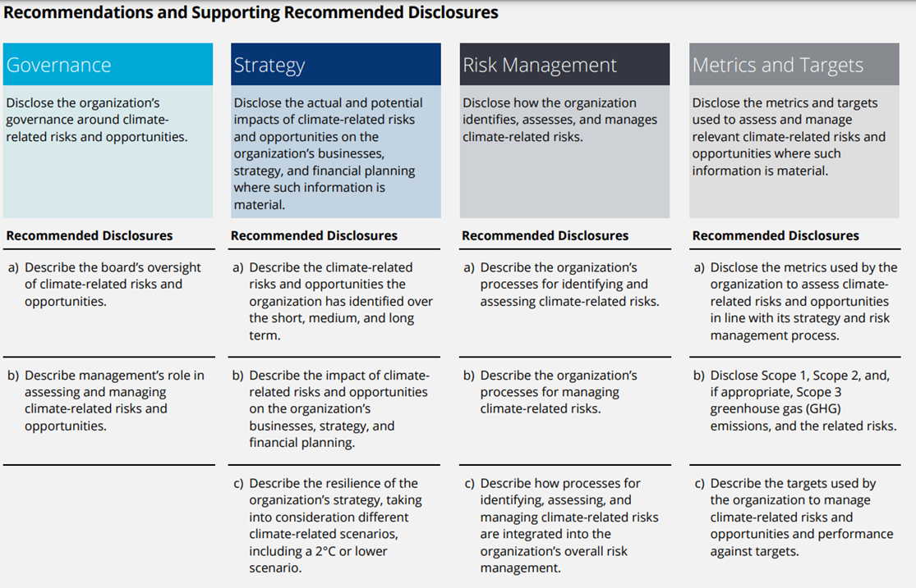
Recommended Disclosures
Source: https://www.fsb-tcfd.org/recommendations/

Slide 37
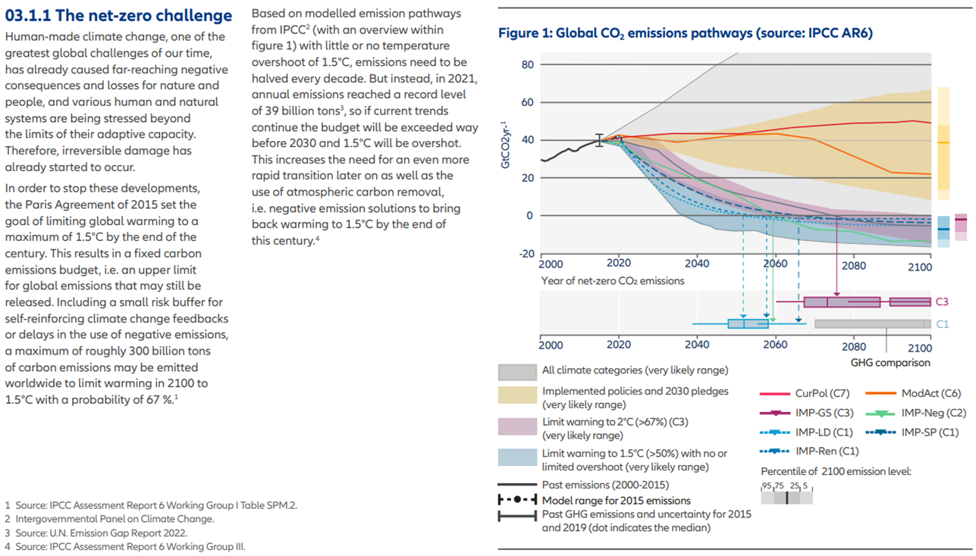
Example: Allianz’s climate-related financial disclosure
Source: https://www.allianz.com/en/sustainability/climate-change/climate-related-financial-disclosure.html

Slide 38
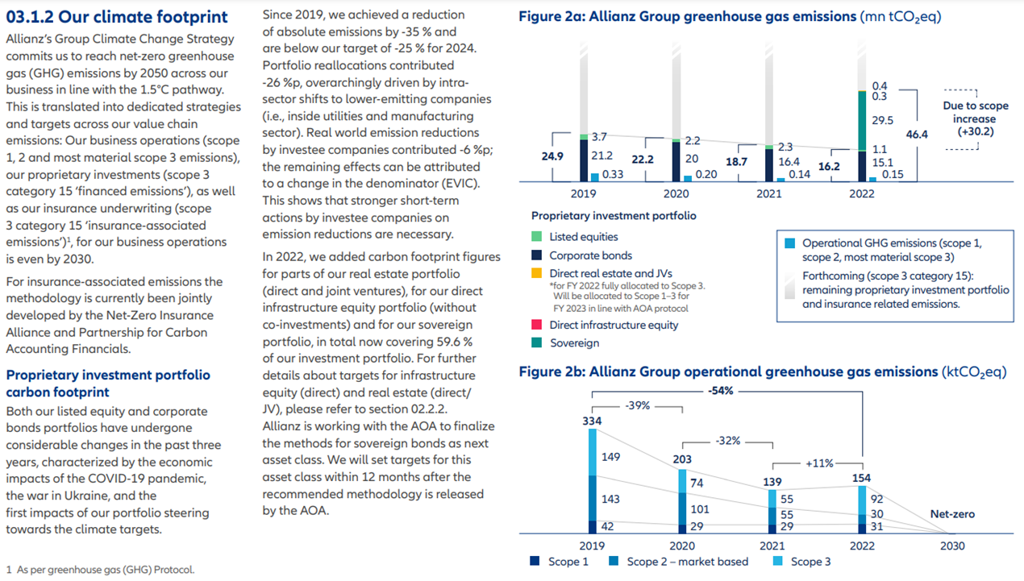
Example: Allianz’s climate-related financial disclosure
Source: https://www.allianz.com/en/sustainability/climate-change/climate-related-financial-disclosure.html

Slide 39
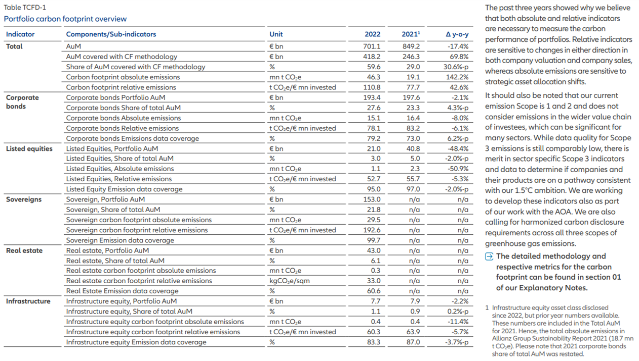
Example: Allianz’s climate-related financial disclosure
Source: https://www.allianz.com/en/sustainability/climate-change/climate-related-financial-disclosure.html

Slide 40

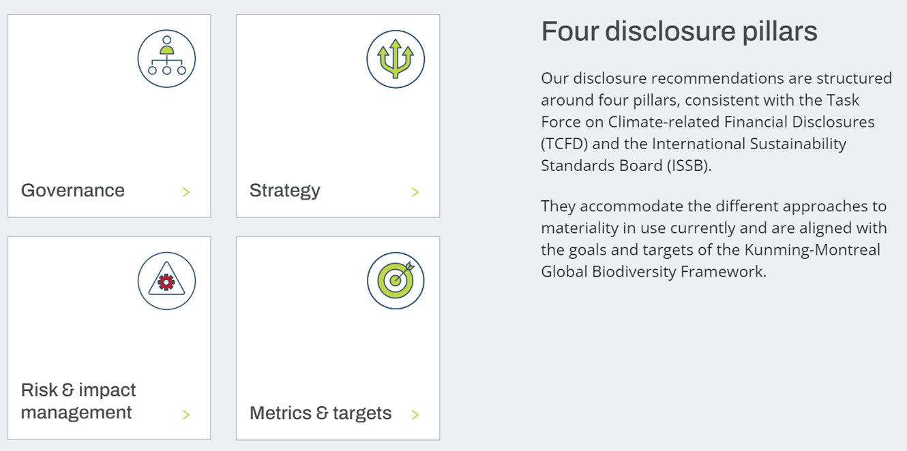
TNFD – TASKFORCE ON NATURE-RELATED FINANCIAL DISCLOSURES
Source: https://tnfd.global/

Slide 41
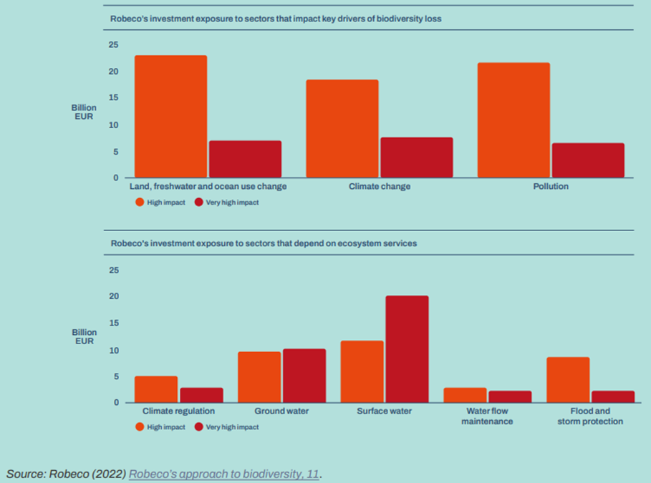
TNFD – GUIDANCE ON THE IDENTIFICATION AND ASSESSMENT OF NATURE-RELATED ISSUES: THE LEAP APPROACH
Guidance to assist institutions to:
1.Scope their assessment
2.Locate their interface with nature
3.Evaluate their dependencies and impacts on nature
4.Assess their nature-related risks and opportunities
5.Prepare to respond to nature-related risks and opportunities and to report on their material nature-related issues.
Source: https://tnfd.global/publication/additional-guidance-on-assessment-of-nature-related-issues-the-leap-approach/#publication-content

Slide 42

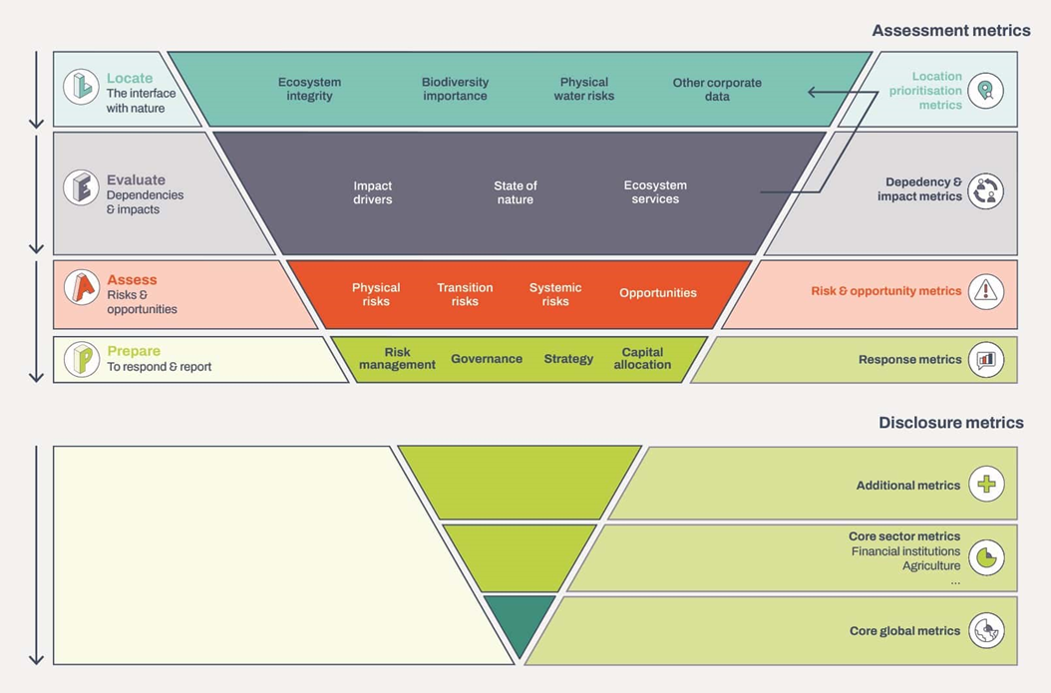
TNFD – DISCLOSURE METRICS
The TNFD’s recommended core disclosure metrics are organised around 14 core global indicators relating to:
  Dependencies and impacts on nature (recommended disclosure Metrics and Targets B); and
  Nature-related risks and opportunities to the organisation (recommended disclosure Metrics and Targets A).
The core global metrics recommended have been selected by the TNFD on the basis that they:
  1. Are relevant across the majority of sectors and commonly incorporated into general or cross-sector standards;
  2. Cover the main drivers of nature change, as identified by the IPBES;
  3. Demonstrate alignment with global policy goals, including those of the GBF and other international conventions and international policy commitments; and
  4. Are decision-useful for report users, including investors, lenders and insurers.
Source: https://tnfd.global/recommendations-of-the-tnfd/#disclosure-metrics

Slide 43
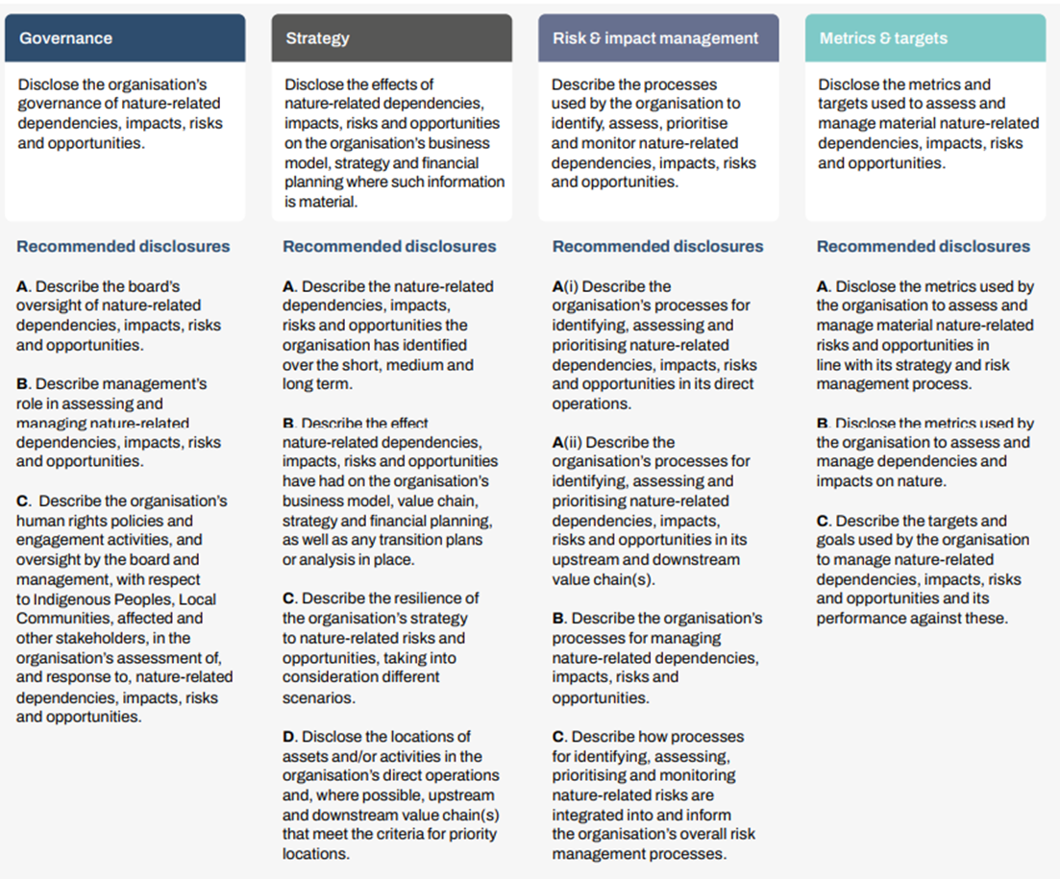
TNFD’s Recommended Disclosures
Source: https://tnfd.global/publication/recommendations-of-the-taskforce-on-nature-related-financial-disclosures/

Slide 44
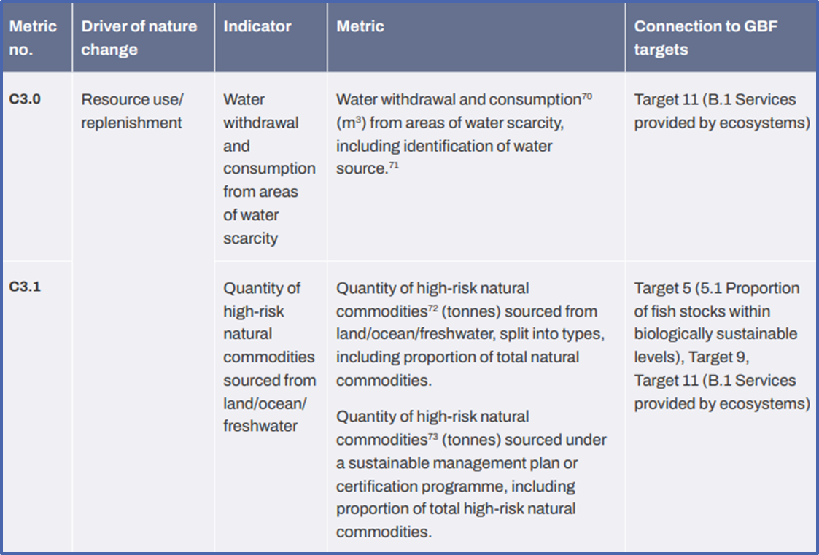
Example Disclosure Metric
Source: https://tnfd.global/wp-content/uploads/2023/08/Recommendations_of_the_Taskforce_on_Nature-related_Financial_Disclosures_September_2023.pdf?v=1695118661

Slide 45

GRI – GLOBAL REPORTING INITIATIVE
GRI is the independent, international organization that helps businesses and other organizations take responsibility for their impacts, by providing them with the global common language to communicate those impacts.
The global standards for sustainability impacts
The GRI Standards enable any organization – large or small, private or public – to understand and report on their impacts on the economy, environment and people in a comparable and credible way, thereby increasing transparency on their contribution to sustainable development. In addition to companies, the Standards are highly relevant to many stakeholders - including investors, policymakers, capital markets, and civil society. ​
The Standards are designed as an easy-to-use modular set, delivering an inclusive picture of an organization's material topics, their related impacts, and how they are managed.
  The Universal Standards - now revised to incorporate reporting on human rights and environmental due diligence, in line with intergovernmental expectations - apply to all organizations;
  The new Sector Standards enable more consistent reporting on sector-specific impacts;
  The Topic Standards - adapted to be used with the revised Universal Standards - list disclosures relevant to a particular topic.
Source: https://www.globalreporting.org/standards/

Slide 46
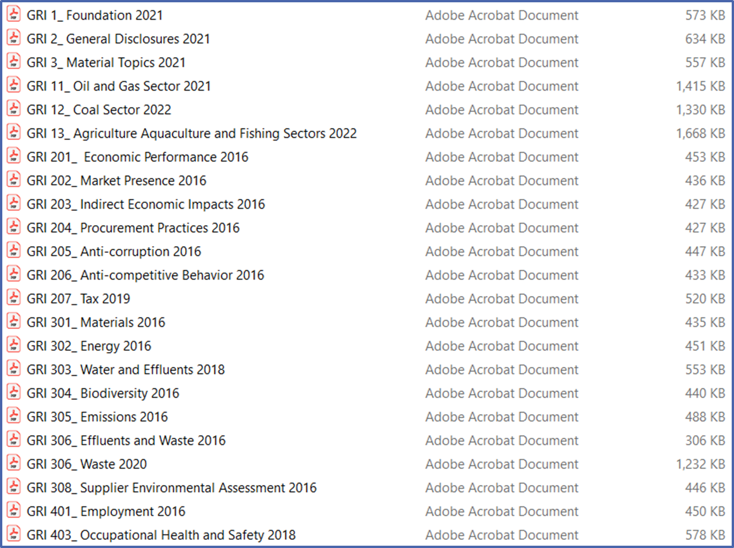
Example: Downloaded GRI Standards
Source: https://www.globalreporting.org/how-to-use-the-gri-standards/gri-standards-english-language/

Slide 47
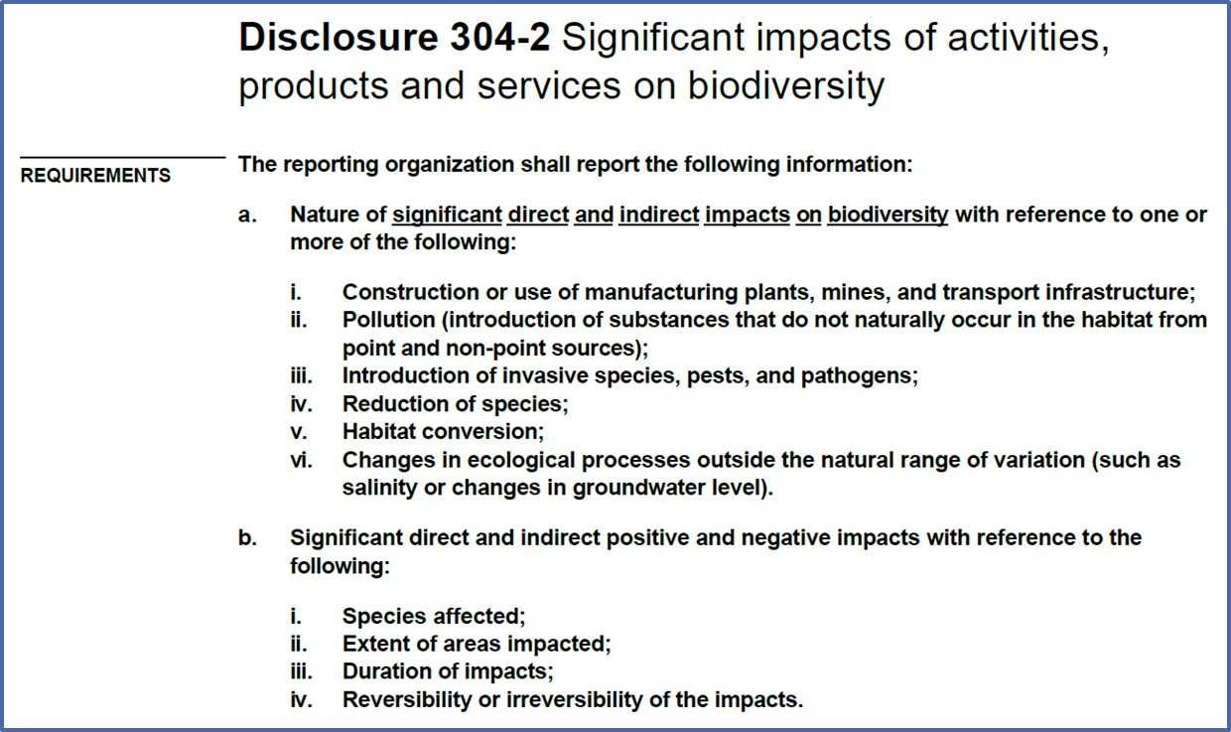
Example: GRI Standards - Biodiversity
Source: https://www.globalreporting.org/how-to-use-the-gri-standards/gri-standards-english-language/

Slide 48

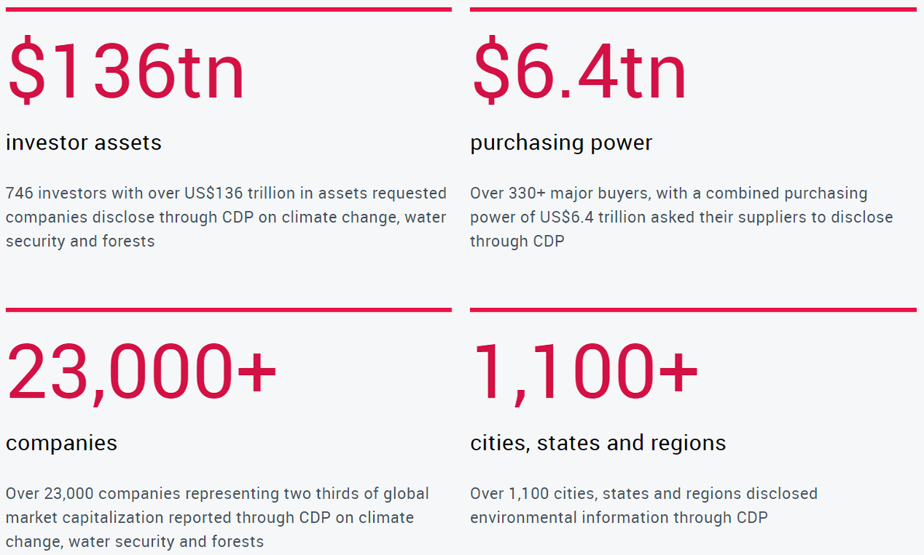
CDP – CARBON DISCLOSURE PROJECT
• CDP is a not-for-profit charity that runs the global disclosure system for investors, companies, cities, states and regions to manage their environmental impacts.
Source: https://www.cdp.net/en/info/about-us/what-we-do

Slide 49
INTEGRATED REPORTING
  The International Integrated Reporting Framework is used to accelerate the adoption of integrated reporting across the world with an aim to:
  Improve the quality of information available to providers of financial capital to enable a more efficient and productive allocation of capital
  Promote a more cohesive and efficient approach to corporate reporting that draws on different reporting strands and communicates the full range of factors that materially affect the ability of an organisation to create value over time
  Enhance accountability and stewardship for the broad base of capitals (financial, manufactured, intellectual, human, social and relationship, and natural) and promote understanding of their independencies
  Support integrated thinking, decision-making and actions that focus on the creation of value over the short, medium and long term.
Link: https://www.integratedreporting.org/resource/international-ir-framework/

Slide 50
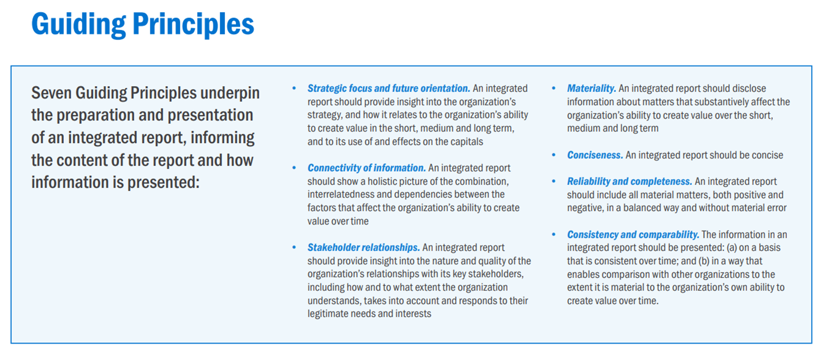
GUIDING PRINCIPLES
Source: https://www.integratedreporting.org/international-framework-downloads/

Slide 51
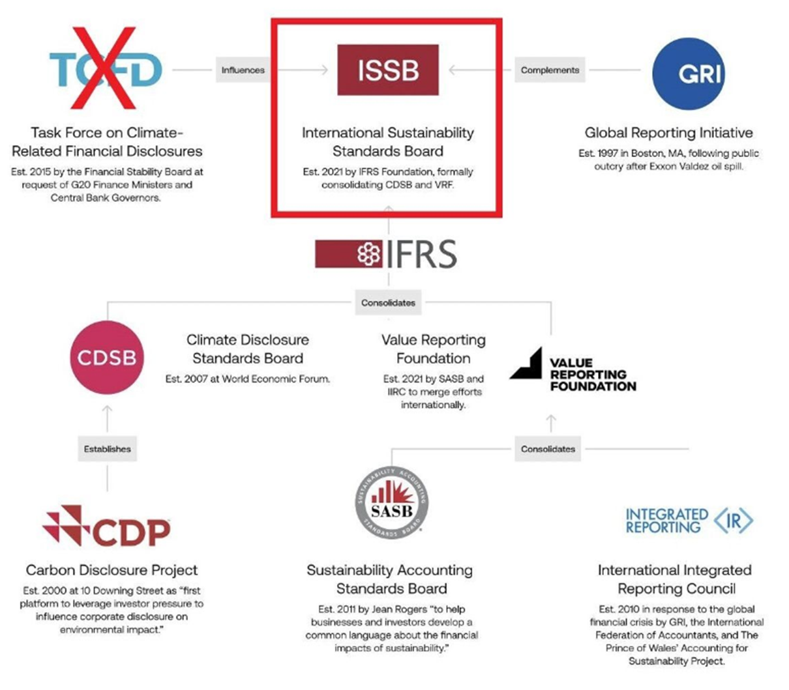
International Sustainability Standards Board
Source: https://www.linkedin.com/posts/david-carlin7_climate-issb-tcfd-activity-7112482647892746240-Ap8u/

Slide 52

ISSB – INTERNATIONAL SUSTAINABILITY STANDARDS BOARD
The ISSB has set out four key objectives:
  to develop standards for a global baseline of sustainability disclosures;
  to meet the information needs of investors;
  to enable companies to provide comprehensive sustainability information to global capital markets; and
  to facilitate interoperability with disclosures that are jurisdiction-specific and/or aimed at broader stakeholder groups.
The ISSB builds on the work of market-led investor-focused reporting initiatives, including the Climate Disclosure Standards Board (CDSB), the Task Force for Climate-related Financial Disclosures (TCFD), the Value Reporting Foundation’s Integrated Reporting Framework and industry-based SASB Standards, as well as the World Economic Forum’s Stakeholder Capitalism Metrics.
  The standards are developed with efficiency in mind, helping companies to report what is needed globally to investors across markets globally.
  The standards are designed to provide the right information, in the right way, to support investor decision-making and facilitate international comparability to attract capital.
  A company can avoid double-reporting by applying the ISSB’s standards. When jurisdictional requirements build on the global baseline, companies are able to meet jurisdictional requirements while benefiting from the efficiency and comparability of the global baseline.
Source: https://www.ifrs.org/groups/international-sustainability-standards-board/

Slide 53
IFRS S1 GENERAL REQUIREMENTS FOR DISCLOSURE OF SUSTAINABILITY-RELATED FINANCIAL INFORMATION
The objective of IFRS S1 is to require an entity to disclose information about its sustainability-related risks and opportunities that is useful to users of general purpose financial reports in making decisions relating to providing resources to the entity.
IFRS S1 requires an entity to disclose information about all sustainability-related risks and opportunities that could reasonably be expected to affect the entity’s cash flows, its access to finance or cost of capital over the short, medium or long term (collectively referred to as ‘sustainability-related risks and opportunities that could reasonably be expected to affect the entity’s prospects’).
IFRS S1 prescribes how an entity prepares and reports its sustainability-related financial disclosures. It sets out general requirements for the content and presentation of those disclosures so that the information disclosed is useful to users in making decisions relating to providing resources to the entity.
IFRS S1 sets out the requirements for disclosing information about an entity’s sustainability-related risks and opportunities. In particular, an entity is required to provide disclosures about:
the governance processes, controls and procedures the entity uses to monitor, manage and oversee sustainability-related risks and opportunities;
the entity’s strategy for managing sustainability-related risks and opportunities;
the processes the entity uses to identify, assess, prioritise and monitor sustainability-related risks and opportunities; and
the entity’s performance in relation to sustainability-related risks and opportunities, including progress towards any targets the entity has set or is required to meet by law or regulation.
Source: https://www.ifrs.org/issued-standards/ifrs-sustainability-standards-navigator/ifrs-s1-general-requirements/

Slide 54
IFRS S2 CLIMATE-RELATED DISCLOSURES
The objective of IFRS S2 is to require an entity to disclose information about its climate-related risks and opportunities that is useful to users of general purpose financial reports in making decisions relating to providing resources to the entity. IFRS S2 requires an entity to disclose information about climate-related risks and opportunities that could reasonably be expected to affect the entity’s cash flows, its access to finance or cost of capital over the short, medium or long term (collectively referred to as ‘climate-related risks and opportunities that could reasonably be expected to affect the entity’s prospects’). IFRS S2 applies to:
climate-related risks to which the entity is exposed, which are:
    climate-related physical risks; and
    climate-related transition risks; and
climate-related opportunities available to the entity.
IFRS S2 sets out the requirements for disclosing information about an entity’s climate-related risks and opportunities. In particular, IFRS S2 requires an entity to disclose information that enables users of general purpose financial reports to understand:
the governance processes, controls and procedures the entity uses to monitor, manage and oversee climate-related risks and opportunities;
the entity’s strategy for managing climate-related risks and opportunities;
the processes the entity uses to identify, assess, prioritise and monitor climate-related risks and opportunities, including whether and how those processes are integrated into and inform the entity’s overall risk management process; and
the entity’s performance in relation to its climate-related risks and opportunities, including progress towards any climate-related targets it has set, and any targets it is required to meet by law or regulation.
Source: https://www.ifrs.org/issued-standards/ifrs-sustainability-standards-navigator/ifrs-s2-climate-related-disclosures/

Slide 55

GHG PROTOCOL - GREENHOUSE GAS PROTOCOL
Launched in 1998, the mission of GHG Protocol is to develop internationally accepted greenhouse gas (GHG) accounting and reporting standards and tools, and to promote their adoption to achieve a low emissions economy worldwide.
GHG Protocol supplies the world's most widely used greenhouse gas accounting standards. The Corporate Accounting and Reporting Standard provides the accounting platform for virtually every corporate GHG reporting program in the world.
The aim of any update to the standards will be to align with best practice approaches to ensure GHG Protocol standards for scope 1, scope 2 and scope 3 are effective in providing a rigorous and credible accounting foundation for businesses to measure, plan and track progress toward science-based and net-zero targets in line with the global 1.5°C goal. Any future updates will seek harmonization and alignment with accounting rules under development through major disclosure initiatives.
As with all Greenhouse Gas Protocol standards, any updates or development of additional guidance will be subject to an inclusive, global, multi-stakeholder decision-making process, with participation from business, NGOs, academia, and government worldwide.
Source: https://ghgprotocol.org/ghg-protocol-standards-and-guidance-update-process-0

Slide 56
GHG PROTOCOL – CORPORATE GHG INVENTORY
The business goals for developing inventories are:
  Understand operational risks and opportunities (e.g. exposure to GHG regulations)
  Track and Reduce emissions (e.g. develop performance benchmarks and assess performance of peers)
  Report to stakeholders (e.g. report to government reporting programs)
“Boundaries” in GHG inventory include defining:
  Organizational boundaries (determine which company operations to include) and
  Operational boundaries (determine which emissions sources to include and determine how to categorize emissions)
Source: https://ghgprotocol.org/ghg-protocol-standards-and-guidance-update-process-0

Slide 57
GHG PROTOCOL – GHG INVENTORY
Why are Operational Boundaries important? i) they help determine which sources of emissions to include ii) classify sources to avoid double-counting ii) provide more useful information to stakeholders and iv) help manage GHG risks and opportunities along the value chain
Setting operational boundaries: i) Identify emissions associated with operations ii) classify emissions as direct or indirect iii) Categorize the “scope” of emissions
Direct emissions are from sources owned or controlled by the reporting company. Indirect emissions are the consequence of the activities of the reporting company but occur at sources owned or controlled by another company.
Th GHG Protocol Corporate Standard classifies a company’s GHG emissions into three ‘scopes’.
  Scope 1 emissions are direct emissions from owned or controlled sources.
  Scope 2 emissions are indirect emissions from the generation of purchased energy.
  Scope 3 emissions are all indirect emissions (not included in scope 2) that occur in the value chain of the reporting company, including both upstream and downstream emissions.
Source: https://ghgprotocol.org/ghg-protocol-standards-and-guidance-update-process-0

Slide 58
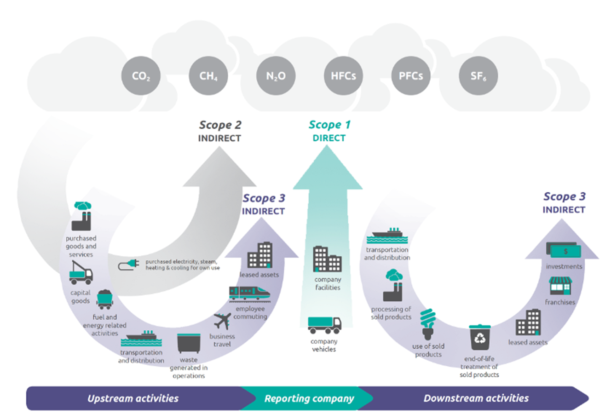
Overview of GHG Protocol scopes and emissions across the value chain
Source: https://ghgprotocol.org/sites/default/files/standards/Corporate-Value-Chain-Accounting-Reporing-Standard_041613_2.pdf

Slide 59
ESG FUND LABELS
These funds are either labelled or marketed as ESG funds. Market expectations, label standards and regulation are changing continuously in this space.
Fund labels are important because they assist institutional investors and beneficiaries to understand where their money is and how it’s being managed.
Fund labels assist with comparability. It can be a challenge to compare funds one by one on ESG when there are hundreds to choose from.
Fund labels assist with communication. Investors are expected to communicate their ESG practices to various stakeholders and standardized or generally accepted fund labels can assist with this.
Fund labels assist in growth of the ESG market. Many beneficiaries’ preferences are not incorporated yet in their investment strategies and fund labels assist with formalizing this potential demand, which in turn will lead investors and companies to incorporate more ESG practices as well. Not only do investors want to provide and sell more ESG funds to clients, but companies can often strive to met ESG criteria in order to be known as an ESG company.

Slide 60
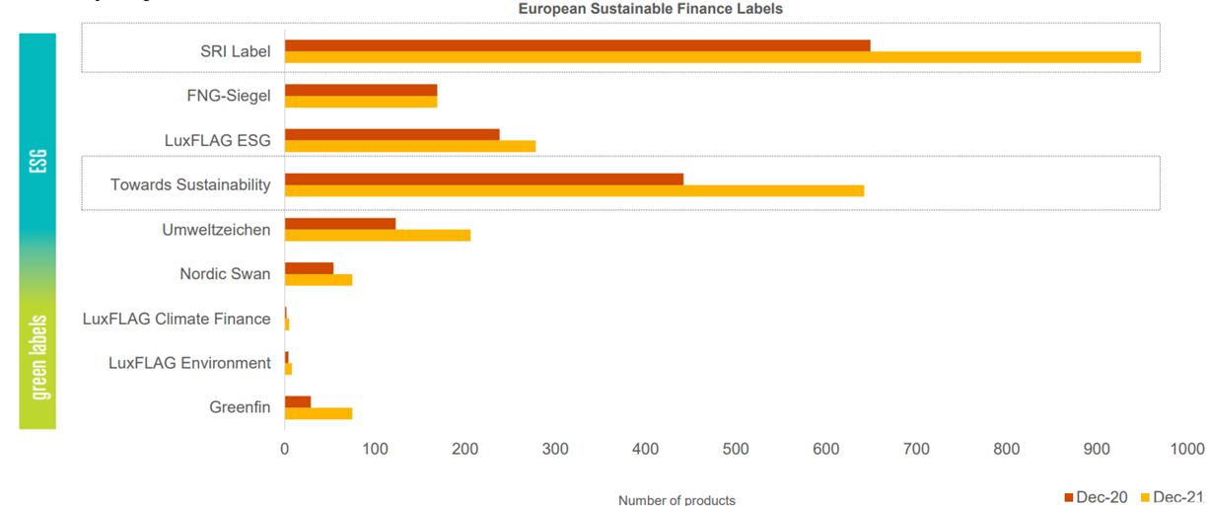
Example – European Fund Labels
Source: https://imas.org.sg/wp-content/uploads/2022/10/ESG-Fund-Labelling-Framework.pdf and Novethic Market Data (Sustainable Labels Europe 31 Dec 2020 & 31 Dec 2021)

Slide 61
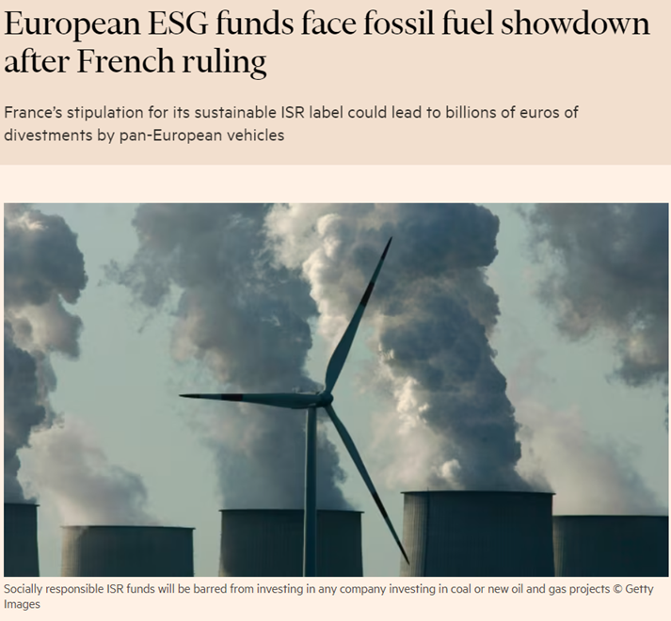
EXAMPLE – LATEST CHANGES ESG LABELS
•Pan-European funds claiming to invest on an environmental, social and governance basis may need to sell all their fossil fuel holdings following a ruling by the French government.
•The move could lead to billions of euros worth of forced divestments over the course of 2024.
… there could be as many as 15 national and European labels by 2025. “You are going to have to make a choice, [for example] say we are not going to align with the French one because we are going to align with the UK one.”
Source: https://www.ft.com/content/4ff287f9-9239-4f38-a12e-3abff50477ca?shareType=nongift

Slide 62
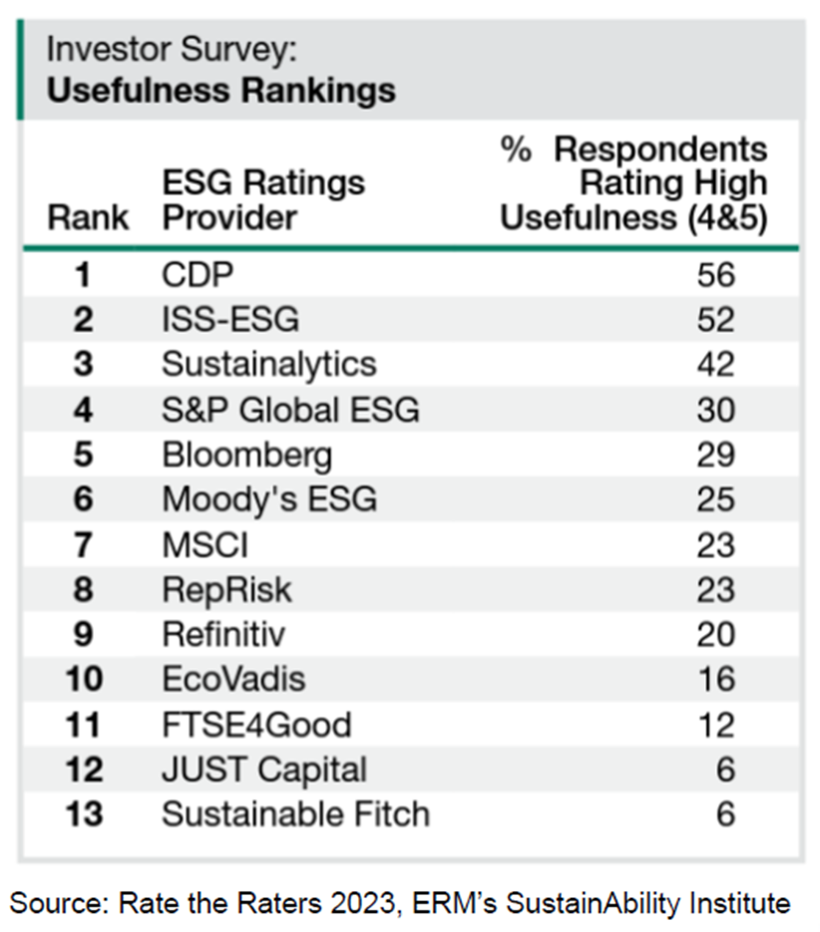
ESG MEASUREMENT
ESG rating firms generate ratings, data, and related products in order to sell them, primarily to institutional investors.
Ratings aggregate information from public (e.g., SEC filings, company reports, press releases, and newswires), quasi-public (e.g., government, regulatory, and NGO data), and private data (e.g., questionnaires).
Data providers attempt to distinguish themselves across various dimensions including
  data collection methodology 2) metric framework and rating methodology 3) coverage 3) focus 4) accuracy 5) transparency and 6) tools
Useful summary to understand the main actors in the market and how they differentiate themselves: https://iriscarbon.com/a-beginners-guide-to-esg-rating-agencies-and-methodologies/
Source: https://www.sustainability.com/globalassets/sustainability.com/thinking/pdfs/2023/rate-the-raters-report-april-2023.pdf

Slide 63
TERMINOLOGY
  ESG rating firm: Any provider of ESG ratings. Most ESG ratings firms produce more than one rating product in order to serve different customer needs.
  ESG rating: Assessments of sustainability performance derived by analysing ESG data, usually numerical scores or letter grades. ESG ratings also exist for nations, sectors, and non-corporate entities.
  ESG ranking: A type of ESG rating in which companies are not assessed on an absolute scale, but instead are ranked “best to worst” related to other companies.
  ESG data: Any information that flows into an ESG rating, either quantitative or qualitative.
  ESG metric: A calculation that aggregates raw data within an ESG dataset to create a measurement that can be used to understand sustainability factors.
  ESG ratings methodology: The sets of rules and algorithms that an ESG rating firm uses to create a rating product from ESG data and metrics.
Link: https://www.sustainability.com/globalassets/sustainability.com/thinking/pdfs/2023/rate-the-raters-report-april-2023.pdf

Slide 64
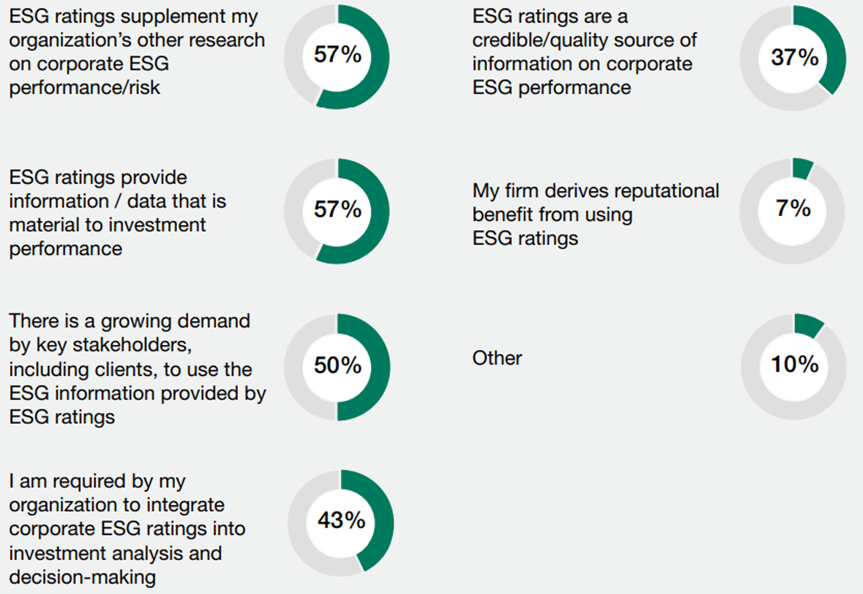
The Most Common Uses of ESG Ratings by Investor Respondents
Source: https://www.sustainability.com/globalassets/sustainability.com/thinking/pdfs/2023/rate-the-raters-report-april-2023.pdf

Slide 65
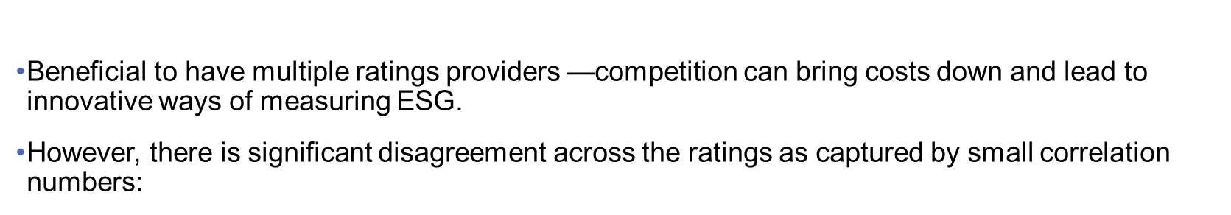
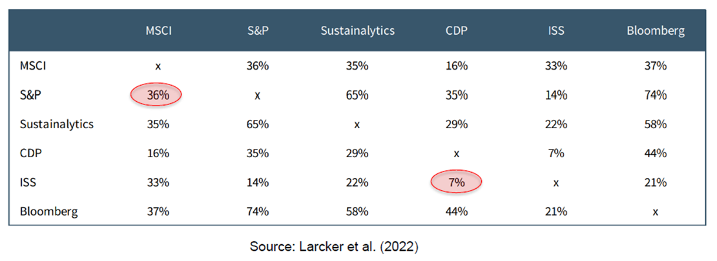
PROS AND CONS OF HAVING MANY RATINGS PROVIDERS

Slide 66
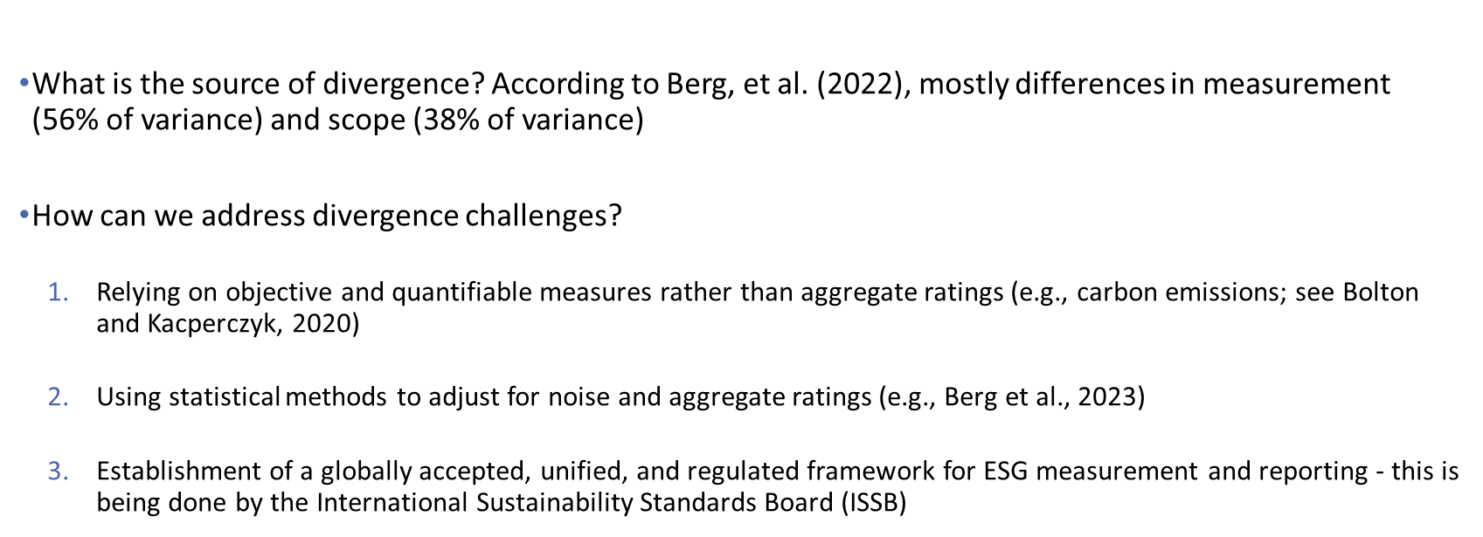
UNDERSTATING ESG RATINGS’ DISAGREEMENT

Slide 67
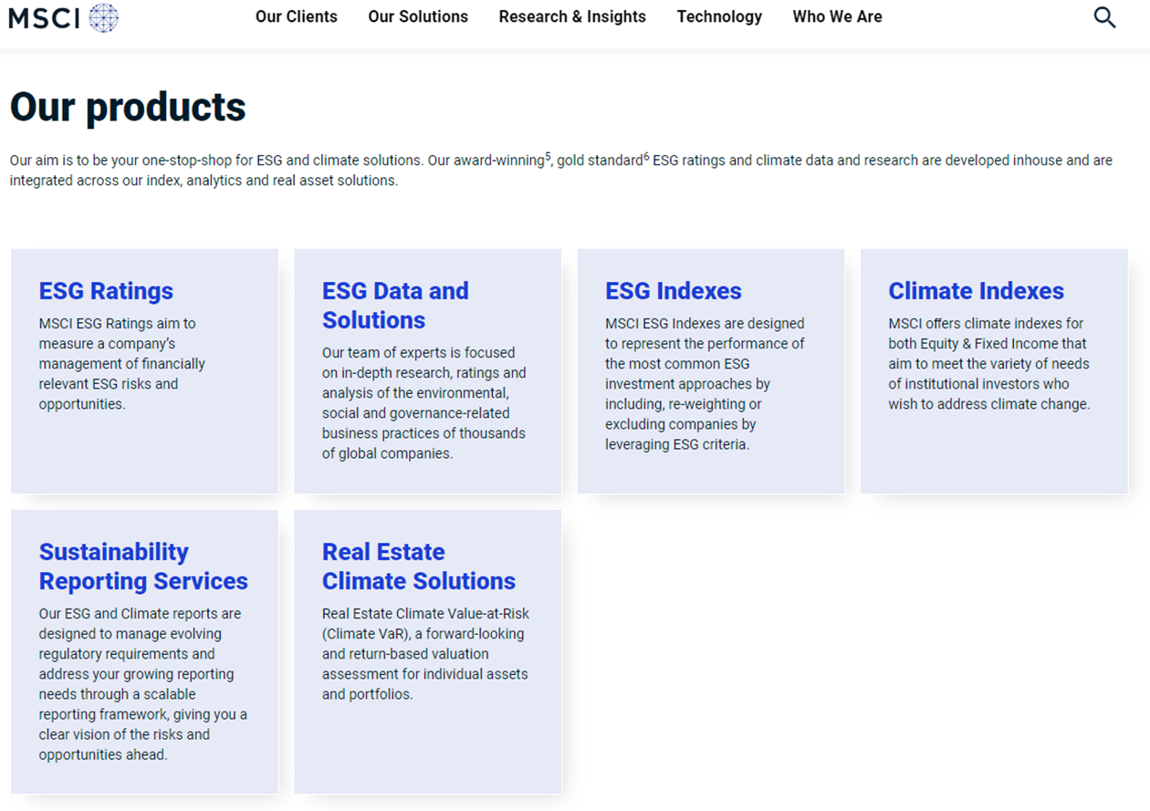
Example:
MSCI
(corporate analysis)
Source: https://www.msci.com/our-solutions/esg-investing

Slide 68
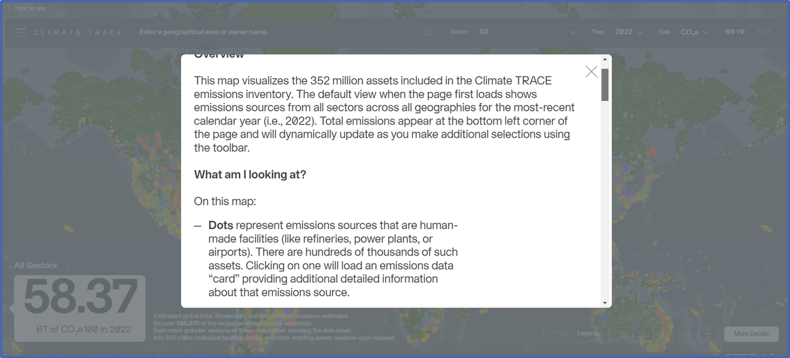
Example:
CLIMATE TRACE
(asset data)
Source: https://www.sustainability.com/globalassets/sustainability.com/thinking/pdfs/2023/rate-the-raters-report-april-2023.pdf

Slide 69
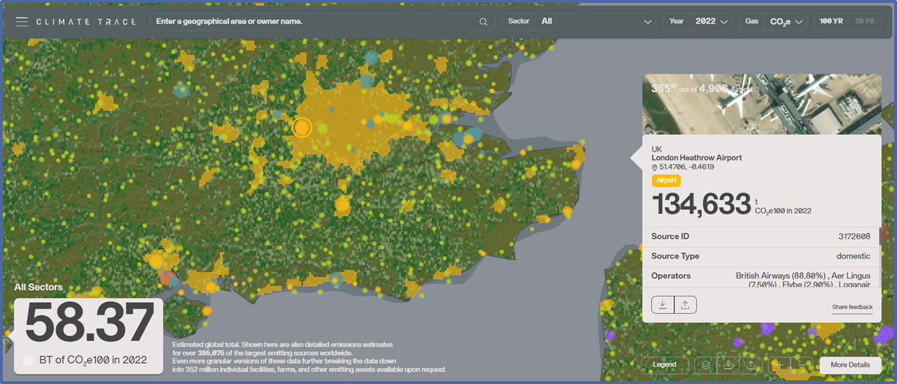
Example:
CLIMATE TRACE
(asset data)
Source: https://www.sustainability.com/globalassets/sustainability.com/thinking/pdfs/2023/rate-the-raters-report-april-2023.pdf

Slide 70

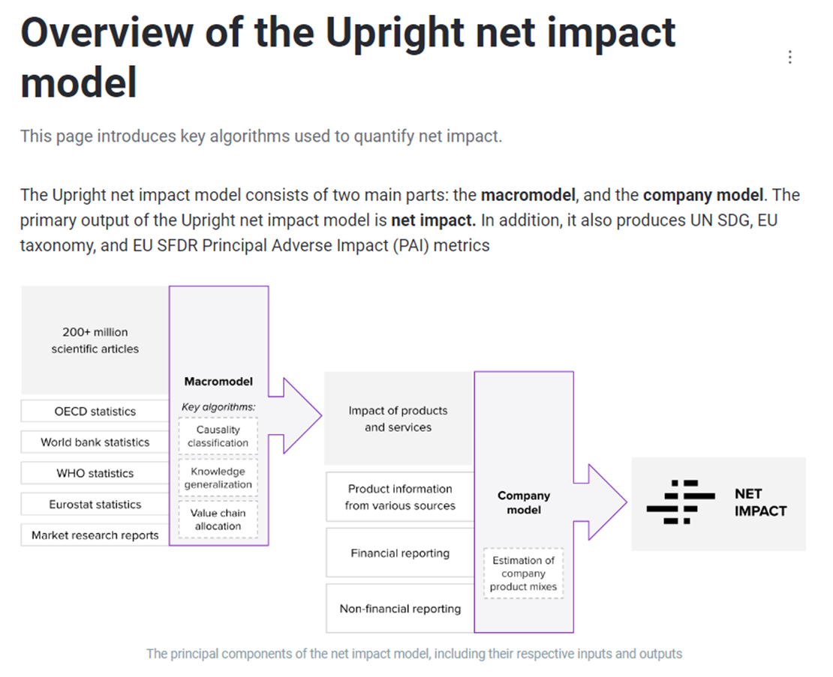
Example:
UPRIGHT
(corporate analysis via products)
Source: https://docs.uprightplatform.com/methodology/net-impact/overview-of-the-upright-net-impact-model

Slide 71
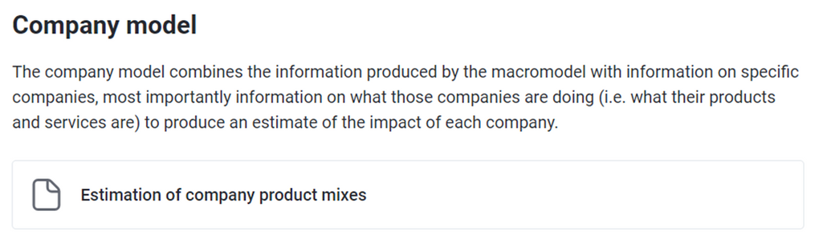
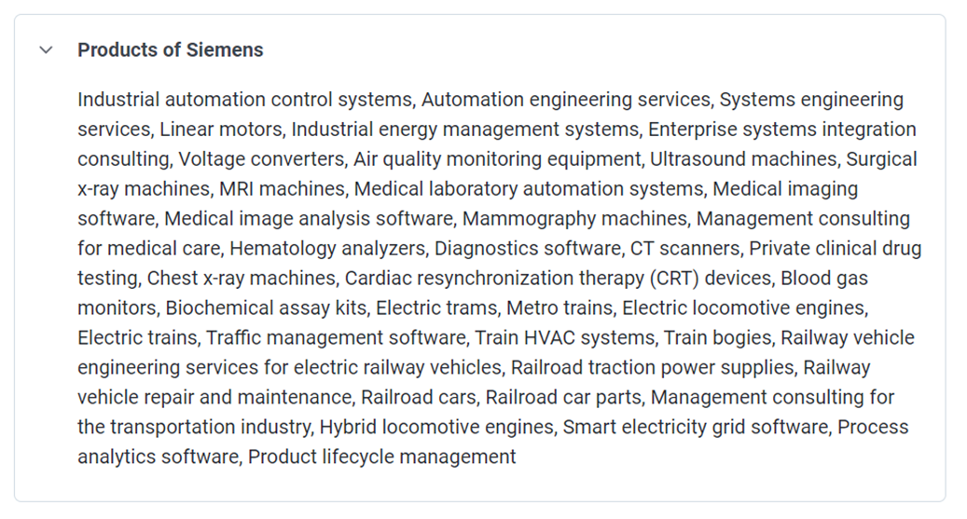
Example:
UPRIGHT
(corporate analysis via products)
Source: https://docs.uprightplatform.com/methodology/net-impact/overview-of-the-upright-net-impact-model

Slide 72
SUSTAINABILITY IN LISTED EQUITY

Slide 73
OVERVIEW
Integrating ESG in the investment process
Active Ownership

Slide 74
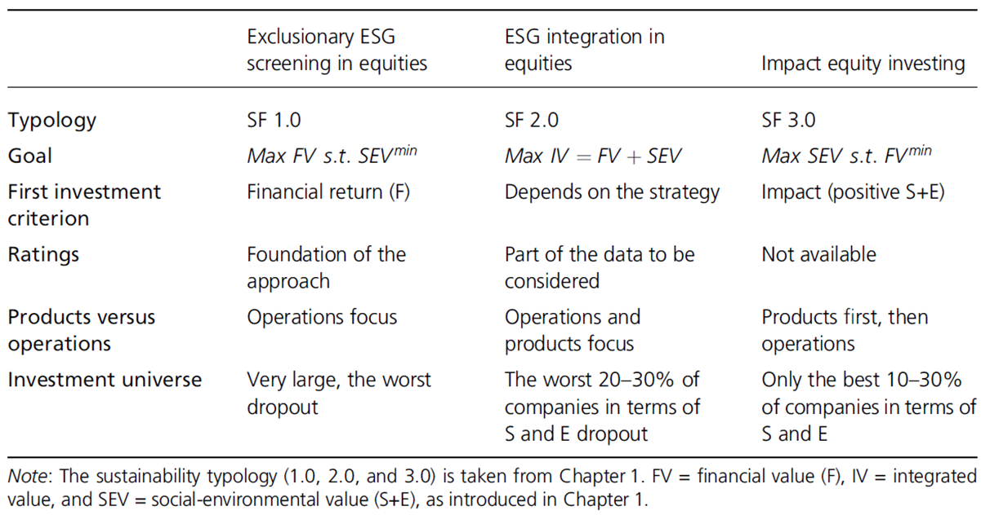
CLASSIFICATION OF ESG APPROACHES IN EQUITY INVESTING
Source: Schoenmaker & Schramade (2018)

Slide 75
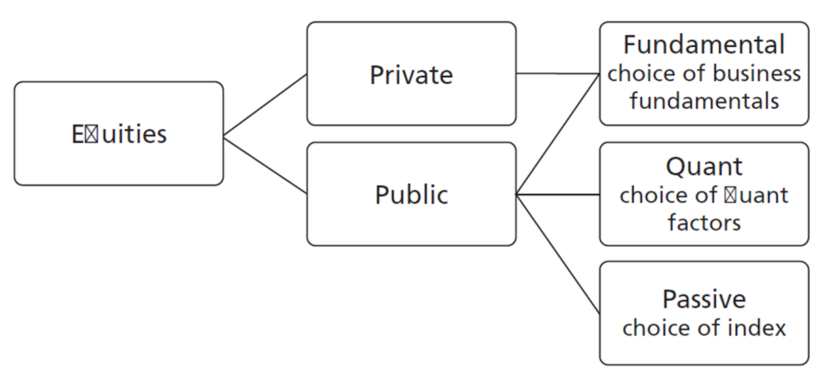
CLASSIFICATION OF EQUITIES INVESTING
Source: Schoenmaker & Schramade (2018)

Slide 76
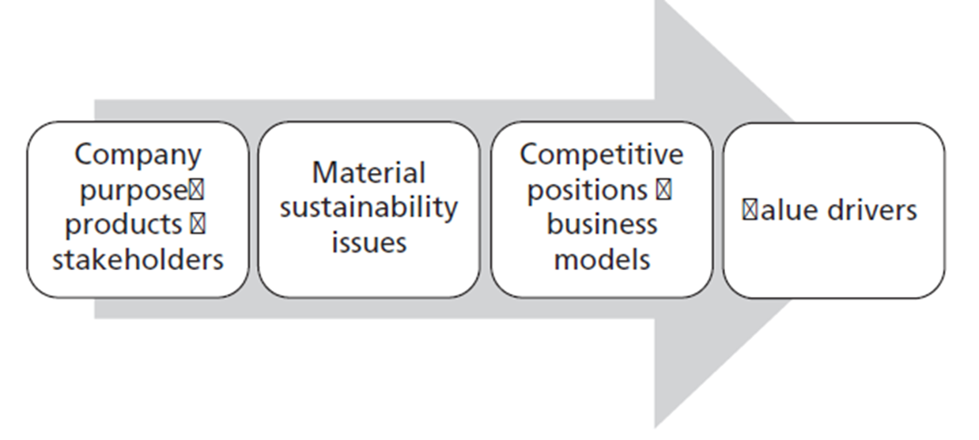
WHY SUSTAINABILITY MATTERS FOR SHAREHOLDER VALUE

Slide 77
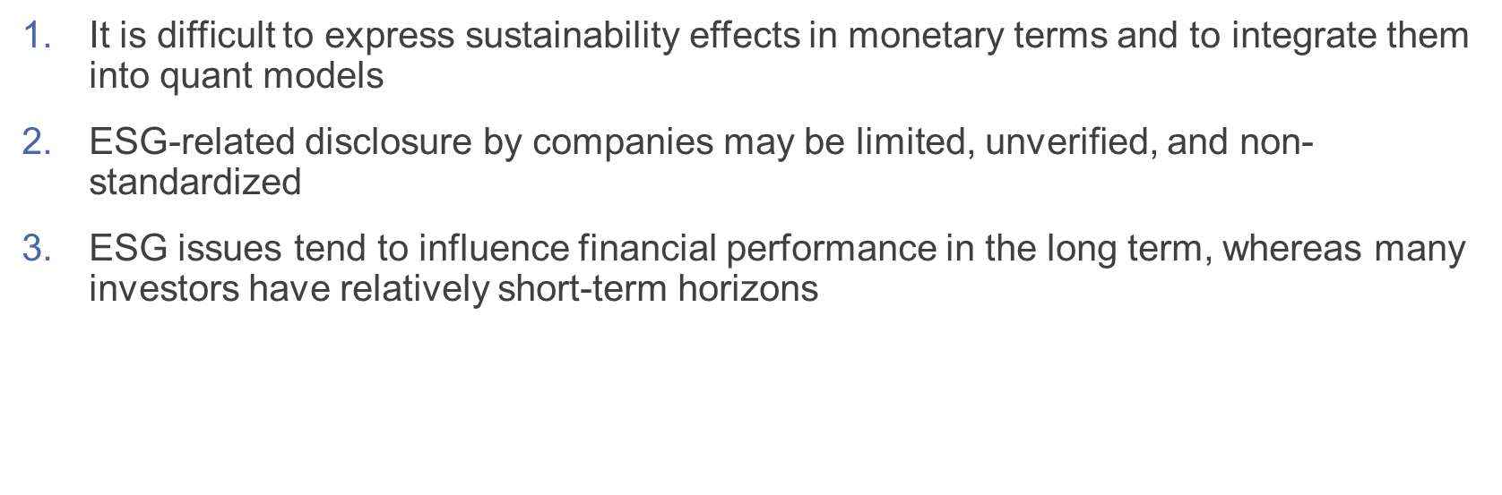
REASONS WHY ESG ISSUES RECEIVE INSUFFICIENT CONSIDERATION IN INVESTMENT CASES

Slide 78

HOW: METHODS FOR CONSIDERING ESG ISSUES
Source: Schoenmaker & Schramade (2018)

Slide 79

SUITABILITY OF METHODS PER TYPE OF INVESTING

Slide 80

STEPS TO INTEGRATE ESG INTO FUNDAMENTAL EQUITY INVESTING

Slide 81
STEP 1: IDENTIFY AND FOCUS ON THE MOST MATERIAL ISSUES
Since material ESG factors, by definition, can have a substantial impact on business models and value drivers, analysts should take them into account in their valuation models. One needs a disciplined approach to identify material ESG factors in the first place. Ideally, one undertakes a materiality analysis of the industry (or has such analyses at one’s disposal for all industries), plotting the likelihood of impact of an ESG issue against its likely size.
So, for example, for a mining company one could identify the management of local stakeholders, environmental management, and operational health and safety as material issues. For a pharmaceutical company, the likely material issues are innovation management, human capital management, and product quality and safety. Then for a particular mining or pharmaceutical company, the importance of an issue can be more or less important than for the industry overall. For example, operational health and safety tends to be even more important for highly manual types of mining (such as in gold or platinum) than in highly mechanized types of mining such as typically found in iron ore mining.

Slide 82
STEP 2: ANALYSE THE IMPACT OF THESE MATERIAL FACTORS ON THE INDIVIDUAL COMPANY
After establishing the material ESG factors, the analyst draws up an assessment of the company’s performance on these factors. Such analysis is not only undertaken on an absolute basis, but also relative to peers, which is critical when establishing whether a company enjoys a competitive advantage (or disadvantage) in managing a given ESG issue.
For example, Novozymes’ competitive edge in human capital and innovation management means that it is able to attract the best talent in enzymes. At the other end of the spectrum, Anglo American’s and Barrick’s weak management of local stakeholder relations resulted in serious local opposition to projects, operational mistakes, and long delays in project ramp-ups (see Chapter 5).

Slide 83

SASB - SUSTAINABILITY ACCOUNTING STANDARDS BOARD
SASB Standards help companies disclose relevant sustainability information to their investors. Available for 77 industries, the SASB Standards identify the sustainability-related risks and opportunities most likely to affect an entity’s cash flows, access to finance and cost of capital over the short, medium or long term and the disclosure topics and metrics that are most likely to be useful to investors.
SASB Standards are industry based. The sustainability-related risks and opportunities that are most likely to affect cash flows, access to finance and cost of capital vary by industry. Industry-based disclosure reduces costs and minimizes noise by surfacing the most relevant information for investors. The Sustainable Industry Classification System was designed to group companies based on shared sustainability-related risks and opportunities to enhance comparability for investor decision-making. As a result, the number of relevant sustainability-related risks and opportunities vary by industry.
Source: https://sasb.org/standards/

Slide 84

Example: Six industries with different sustainability risks and opportunities.
Source: https://sasb.org/standards/materiality-finder/

Slide 85
STEP 3: QUANTIFY COMPETITIVE ADVANTAGES TO ADJUST FOR VALUE DRIVER assumptions
In the next step, the equity analyst makes deliberate, and often significant, adjustments to value drivers that are based on ESG-driven competitive advantages or disadvantages. These changes in value driver assumptions result in changes to the target price and recommendations for the company’s stock. To give a sense of the magnitude of this, if the analyst raises profit margins for all periods from 20 to 23 per cent (that is, a 15 per cent increase) to reflect the company’s proficiency in managing an ESG issue, the target price will likely also go up by 15 per cent, which may be the difference between a HOLD and a BUY recommendation.
In the case of Novozymes, the impact was much bigger as its competitive edge in innovation and talent resulted in superior products that replaced traditional chemicals at double the margins and double the growth rate of the traditional chemicals industry.

Slide 86


Itaú AM: Three climate scenarios
Source: https://www.unpri.org/listed-equity/itau-am-integrating-climate-scenarios-into-investments/10967.article

Slide 87


Robeco: Re-baselining for a net-zero
Source: https://www.unpri.org/climate-change/robeco-re-baselining-for-a-net-zero-commitment/11422.article

Slide 88

VFMC: Portfolio alignment with net zero
Source: https://www.unpri.org/climate-change/vfmc-portfolio-alignment-with-net-zero/11475.article

Slide 89
STEP 4: HAVE AN ACTIVE DIALOGUE WITH THE INVESTEE COMPANY
In the final step, the analyst or portfolio manager uses the knowledge generated in the first three steps to ask the investee company meaningful questions on the management of material ESG issues.
For example, one might ask a strong performer on human capital what the source of its strength is, how that strength is maintained, what kind of internal key performance indicators (KPIs) the company uses, what kind of benefits accrue from that strength in terms of value drivers, and so on. For a weak performer, the questions would be similar, but slightly differently framed, and it would also be asked why the company seems to be underperforming, how it aims to close the gap, and so on.

Slide 90
ACTIVE OWNERSHIP
Active ownership is the use of the rights and position of ownership to influence the activities or behaviour of investee companies. Active ownership can be applied differently in each asset class. For listed equities, it includes engagement and voting activities.
Shareholder engagement captures any interactions between the investor and current or potential investee companies on ESG issues and relevant strategies, with the goal of improving (or identifying the need to influence) ESG practices and/or improving ESG disclosure. It involves a structured process that includes dialogue and continuously monitoring companies. These interactions might be conducted individually or jointly with other investors.
Collaborative engagements include groups of investors working together, with or without the involvement of a formal investor network or other membership organisation.
Voting refers to the exercise of voting rights on management and/or shareholder resolutions to formally express approval (or disapproval) on relevant matters. In practice, this includes taking responsibility for the way votes are cast on topics raised by management, as well as submitting resolutions as a shareholder for other shareholders to vote on (in jurisdictions where this is possible). Voting can be done in person, during an Assembly General Meeting (AGM), or by proxy.
Source: https://www.unpri.org/listed-equity/introduction-to-active-ownership-in-listed-equity-/2719.article

Slide 91

Engagements influence corporate behaviour and investor’s beliefs on the company’s future
Source: Dimson, E., Karakaş, O., & Li, X. (2015). Active ownership. The Review of Financial Studies, 28(12), 3225-3268.

Slide 92

CHALLENGES TO ACTIVE OWNERSHIP
Source: https://www.unpri.org/listed-equity/introduction-to-active-ownership-in-listed-equity-/2719.article

Slide 93

Proxy Voting
Source: https://www.investopedia.com/terms/p/proxy.asp

Slide 94

PROXY VOTING, ESG
Source: https://www.unpri.org/stewardship/making-voting-count-principle-based-voting-on-shareholder-resolutions/7311.article

Slide 95

Market Statistics
Source: https://corpgov.law.harvard.edu/2023/10/04/proxy-voting-insights-key-esg-resolutions/#:~:text=The%202022%20proxy%20year%20marked,compared%20with%2052%25%20in%202022.

Slide 96

Market Statistics
Source: https://corpgov.law.harvard.edu/2023/10/04/proxy-voting-insights-key-esg-resolutions/#:~:text=The%202022%20proxy%20year%20marked,compared%20with%2052%25%20in%202022.

Slide 97
PRIVATE EQUITY AND IMPACT INVESTING

Slide 98
OVERVIEW
ESG in Private Equity
Impact Investing

Slide 99


ESG IN PRIVATE EQUITY (PE)
Source: https://www.unpri.org/introductory-guides-to-responsible-investment/an-introduction-to-responsible-investment-private-equity/4941.article

Slide 100

8.4 IMPACT INVESTING

Slide 101

CHALLENGES OF IMPACT INVESTING

Slide 102

IMPACT MANAGEMENT PROJECT –
5 Dimensions of Impact
Source: https://iris.thegiin.org/document/iris-and-the-five-dimensions/

Slide 103


Slide 104

IRIS+ SYSTEM
IRIS+ is the generally accepted system for impact investors to measure, manage, and optimize their impact.
Credible, comparable impact data are needed to inform impact investment decisions and drive greater impact results. IRIS+ solves for this by increasing data clarity and comparability, and it provides streamlined, practical, how-to guidance that impact investors need, all in one easy-to-navigate system. It is a free, publicly available resource.
IRIS+ makes it easier for investors to translate their impact intentions into real impact results. Use of IRIS+ allows investors to focus their capital allocation decisions and drive greater impact on the world’s most pressing social and environmental issues.
Source: https://iris.thegiin.org/about/

Slide 105

Example: Current themes in IRIS+
Source: https://iris.thegiin.org/upcoming-updates-and-process/

Slide 106

Example: Current themes in IRIS+
Source: https://iris.thegiin.org/upcoming-updates-and-process/

Slide 107

Source: https://thegiin.org/research/publication/2023-giinsight-series/

Slide 108


Use of impact data in the investment process
Source: https://thegiin.org/research/publication/2023-giinsight-series/

Slide 109
SUSTAINABILITY IN FIXED INCOME

Slide 110
OVERVIEW
Bonds
Credit Rating Agencies
Green Bonds

Slide 111
THE BOND MARKET
At the end of 2016, the value of outstanding bonds globally was estimated at $92 trillion (i.e. about 120 per cent of global GDP) versus $70 trillion for outstanding listed equity (SIFMA, 2017). Bonds come in many guises and can be complex, but they have a lot in common as well. Bonds are certificates of debt issued by a government or corporation that promise payment of the borrowed amount, plus interest, by a specified future date.
A bond certificate indicates the amounts and dates of all payments to be made. Payments are made until the final repayment date, known as the maturity date of the bond. The time until the maturity date is known as the term. Bond maturities or terms range from very short term (months) to decades or even perpetuity.
The yield on a bond is the discount rate that sets the present value of its payments equal to its current market price. Yield to maturity of a particular bond reflects the yield received if all coupons received are reinvested at a constant interest rate. Put another way, the yield is the IRR (internal rate of return) of a bond.

Slide 112

TYPES OF BONDS

Slide 113

THE BOND MARKET
Equity holders have all the upside and limited downside risk, while bondholders have limited upside and all downside risk. some fixed-income
Investors are equally if not more concerned than equity investors about ESG exposures since they can have pronounced effects on performance by generating tail risks.
In general, ESG performance influences spreads, credit ratings, cost of debt and yields.

Slide 114

Correlation of country ESG scores and credit ratings

Slide 115

Control of corruption versus foreign credit rating

Slide 116
EVOLVING PRACTICE AND SPACE
Rankings and changes can be used to adjust portfolio weights in a sovereign bond portfolio, which is in effect a quant approach. But of course, one could use the sustainability scores in a fundamental approach as well, to adjust for those factors that are not well captured by the ranking.
  In fact, the CFA Institute (2017) cites Robeco’s emerging debt team in using the change in rankings to adjust its Brazilian sovereign bonds exposure. However, it is not clear what mechanism Robeco uses exactly.
Ideally, in a fundamental ESG-integrated approach to sovereign bonds investing, the ESG assessment should show up in an analyst recommendation, preferably via its valuation and rating.
ESG integration in corporate bonds is more practised than in sovereign bonds. In practice, such efforts are usually limited to ESG specialists raising red flags on specific bonds, mostly on governance issues, which remain the focus.

Slide 117
9.1 INTERVIEW WITH A CORPORATE BONDS FUND MANAGER
“Our process is driven by materiality. Companies with low scores and ratings require further analysis and may lead us to adjust our credit assessment”
“The fact that bonds trade in an OTC (over the counter) market, also makes it hard for companies to identify their bondholders after issuance. In the pre-issue phase it is much easier to engage, as you will have companies visiting. Overall, engagement is simply not yet as institutionalised in fixed income as it is in equities.”
“You can see the impact of ESG on the price of credit quality, which itself varies over time and is not solely driven by fundamentals.”
“The challenge is how to best educate analysts on (the importance of) ESG issues and—in return—how to encourage analysts to educate ESG team members and ESG data providers on practical matters. There is still a lot to learn from each other in order to take ESG to the next level for corporate bonds!”

Slide 118

Credit Rating Agencies
Source: https://www.unpri.org/credit-risk-and-ratings/esg-in-credit-ratings-and-esg-ratings/11071.article

Slide 119
CHARACTERISTICS OF CRAS
Time Horizon: Credit ratings are not dependent on specific fixed time horizons as they are CRAs’ best assessment of foreseeable credit risks. As a general principle, with lengthening time horizons, CRAs are less certain of how risks, including ESG risks, can impact issuers’ cash flow generating ability and on other credit metrics. Therefore, they focus on issues where there is more clarity, which tend to be short to medium term.
Operating Model: A credit rating assessment is an independent opinion typically initiated and paid for by the issuer. The majority of ratings are solicited by the rated entity. However, CRAs can also produce unsolicited ratings. For example, sovereign ratings are typically unsolicited.
Methodology: CRAs’ credit rating methodologies are publicly available. CRAs also provide the key drivers or issues that underlie the rationale for a specific credit rating, or change in credit rating, in ratings’ reports. The relative weighting of the issues considered in the determination of a credit rating is sometimes disclosed to investors.
Source: https://www.unpri.org/credit-risk-and-ratings/esg-in-credit-ratings-and-esg-ratings/11071.article

Slide 120
HOW DO CREDIT RATINGS CONSIDER ESG FACTORS?
CRAs consider the E, S and G factors that are material for their analysis in their credit risk assessments, i.e. factors that may affect the relative ranking of risk for an issuer or single issue:
  For example, carbon intensity is credit-relevant only if it financially affects the issuer’s ability to meet its obligations including operating costs and debt service in the foreseeable future. In jurisdictions where there is a carbon price or tight regulation, an issuer’s carbon intensity would be credit-relevant as it would imply additional costs. Credit relevance would also depend on the sector in which the rated entity operates and on its credit profile, including its ability to absorb the impact of such costs.
To enhance the transparency of the impact of ESG factors on credit ratings, some CRAs have started to produce scores highlighting how such factors are credit-relevant. These scores are proposed by the credit analyst, who assesses the impact of E, S and G issues separately, then they are reviewed by the ratings’ committee before being communicated alongside the credit rating. It is important to recognise that these scores are not ESG assessments of the issue or issuer but are used to communicate to investors the extent to which ESG factors are a driver of the final credit rating.
Source: https://www.unpri.org/credit-risk-and-ratings/esg-in-credit-ratings-and-esg-ratings/11071.article

Slide 121

Evolution of the landscape of ESG information providers
Source: https://www.unpri.org/credit-risk-and-ratings/esg-in-credit-ratings-and-esg-ratings/11071.article

Slide 122

GREEN BONDS

Slide 123

CLIMATE BONDS INITIATIVE - CBI
CBI standard: The Climate Bonds Standard and Certification Scheme is a labelling scheme for Entities, Assets and Debt Instruments.
Rigorous scientific criteria ensure that Certified investments in climate mitigation are consistent with the 1.5C warming limit in the Paris Agreement.
The Scheme is used globally by bond issuers, governments, investors and the financial markets to prioritise investments which genuinely contribute to addressing climate change.
The Climate Bonds Taxonomy is a guide to climate aligned assets and projects. It is a tool for issuers, investors, governments and municipalities to help them understand what the key investments are that will deliver a low carbon economy. The Taxonomy is grounded in the latest climate science and has been developed through an extensive multistakeholder approach, leveraging the work of our Technical and Industry Working Groups.
A key part of the Standard is a suite of sector-specific eligibility Criteria. Each Sector Criteria sets climate change benchmarks for that sector that are used to screen assets and capital projects so that only those that have climate integrity, either through their contribution to climate mitigation, and/or to adaptation and resilience to climate change, will be certified. Where a bond encompasses a mixed portfolio of assets across several sectors, each sub-category of assets will be subject to the relevant Sector Criteria for those assets.
Source: https://www.climatebonds.net/standard/the-standard

Slide 124


Climate Bonds Standard and Requirements for Certification
Source: https://www.climatebonds.net/files/files/CBI_Standard_V4.pdf

Slide 125

Climate Bonds Taxonomy
Source: https://www.climatebonds.net/standard/taxonomy

Slide 126


Slide 127
SUSTAINABILITY REGULATION

Slide 128

CLIMATE CHANGE LAWS
The Climate Change Laws of the World database builds on more than a decade of data collection by the Grantham Research Institute at LSE and the Sabin Center at Columbia Law School. The database is powered by machine learning and natural language processing technology developed by Climate Policy Radar.
Climate Change Laws of the World covers national-level climate change legislation and policies globally. The database covers climate and climate-related laws, as well as laws and policies promoting low carbon transitions, which reflects the relevance of climate policy in areas including energy, transport, land use, and climate resilience.
Source: https://climate-laws.org/

Slide 129

SUSTAINABLE FINANCE REGULATION
Source: https://www.unpri.org/policy/regulation-database

Slide 130

GROWTH IN ESG REPORTING INSTRUMENTS
Source: https://www.unpri.org/policy/regulation-database

Slide 131


Slide 132


EU TAXONOMY
Source: https://ec.europa.eu/sustainable-finance-taxonomy/

Slide 133



HOW CAN ACTIVITIES QUALIFY UNDER THE EU TAXONOMY?
Source: https://ec.europa.eu/sustainable-finance-taxonomy/

Slide 134


TECHNICAL SCREENING CRITERIA
Source: https://finance.ec.europa.eu/regulation-and-supervision/financial-services-legislation/implementing-and-delegated-acts/taxonomy-regulation_en#environmental

Slide 135

Example: Technical Screening Criteria for climate change mitigation or climate change adaptation
Source: https://eur-lex.europa.eu/legal-content/EN/TXT/PDF/?uri=CELEX:32021R2139&from=EN

Slide 136

Example: Technical Screening Criteria – Determining the conditions under which an economic activity qualifies as contributing substantially to the sustainable use and protection of water and marine resources, to the transition to a circular economy, to pollution prevention and control, or the protection and restoration of biodiversity and ecosystems
Source: https://eur-lex.europa.eu/legal-content/EN/TXT/PDF/?uri=CELEX:32021R2139&from=EN

Slide 137
STEP 1: TAXONOMY ELIGIBILITY
Then there are three types of activities that can be included in the Taxonomy
Primary activities, which directly contribute substantially to one of the six environmental objectives.
Transitional activities which support the transition to a climate-neutral economy.
Enabling activities, which facilitate the primary activities indirectly.
In 2021, two legally binding acts were published in the Official Journal of the European Union that further define detailed measures outlined in the Taxonomy Regulation, referred to as Delegated Acts.
The first act is the “Climate Delegated Act”, which defines the technical screening criteria for economic activities that can make a substantial contribution to climate change mitigation and climate change adaptation and the technical screening criteria to ensure those activities do no significant harm to any of the other environmental objectives. By meeting technical screening criteria of the EU taxonomy, these economic activities can become qualified as “environmentally sustainable”, (“Taxonomy-aligned”) activities. The “Complementary Climate Delegated Act” published in 2022 adds, under strict conditions, specific nuclear and gas energy related activities covered by the EU taxonomy.
The first question a company should ask itself is: which of the activities performed by my company are covered by the EU Taxonomy?
  For example, a construction company could list its services that are supporting the construction of low carbon buildings or activities that are supporting the reduction of the most important physical climate risks to their own operation or others as potentially Taxonomy eligible activities
Next, the company needs to screen those activities against the list set out in the annexes of the Climate Delegated Act and Complementary Climate Delegated Act to gain an overview of which activities fall within the scope of the EU Taxonomy.
  For example, the EU Taxonomy Compass highlights that the following activities are currently potentially eligible for construction real estate activities (1) construction of new buildings (2) renovation of existing buildings, (3) installation, maintenance and repair of energy efficiency equipment
Source: EU Taxonomy User Guide https://ec.europa.eu/sustainable-finance-taxonomy/

Slide 138
TAXONOMY ALIGNMENT
Check whether your investment is aligned with the description of the relevant activity included in the Annex I to the Climate Delegated Act and the Complementary Climate Delegated Act.
  For example, for energy efficiency measures, refer to activity “7.3 installation, maintenance and repair of energy efficiency equipment”: Individual renovation measures consisting in installation, maintenance or repair of energy efficiency equipment (the economic activities in this category could be associated with several NACE codes)
Next is to understand what is required for the activity to be compliant (i.e. aligned) with the technical screening criteria for a substantial contribution to climate change mitigation. It is likely that the criteria will require the collection of specific data or information. It is therefore advised to already start defining actions to be taken to prepare the assessment (e.g. identify data requirements, identify sources for data collection, define responsibilities and timeline for data collection, define data quality checks, etc.)
  For example, in the case of investment in energy efficiency equipment, the criteria include (1) the reference to relevant compliance requirements at EU or national level (e.g., applicable national measures implementing the recast Energy Performance of Buildings Directive 2010/31/EU) and (2) specific individual measures considered as eligible (e.g., replacement of existing windows with new energy efficient windows.)
Source: EU Taxonomy User Guide https://ec.europa.eu/sustainable-finance-taxonomy/

Slide 139
EU TAXONOMY USER GUIDE - P.24
Helping others to adapt to impacts of climate change
How does your company benefit from the EU Taxonomy if it conducts activities that enable others to adapt to impacts of climate change?
If the associated revenues and capital expenditures and operational expenditures are taxonomy-aligned, reporting them can enhance your reputation and improve access to capital
  Step 1: Check which of your activities, services or solutions that are enabling others to adapt are covered in the EU Taxonomy (check the Climate Delegated Act)
  Step 2: Ensure that the activity fulfils the “technical screening criteria”
  Step 3: Show how you can enable adaptation, assess current and future climate risks for your targeted field of action, client or customer
  Step 4: Demonstrate that the primary objective of your activity is to provideor promote the use of a technology, product, service, information or practice that (1) either increases the level of resilience to physical climate risks, or (2) contributes to adaptation efforts
Source: EU Taxonomy User Guide https://ec.europa.eu/sustainable-finance-taxonomy/

Slide 140
EU TAXONOMY USER GUIDE - P.26
Aligning with best practices in adapting to impacts of climate change: how can a company demonstrate leadership on adapting to the physical impacts of climate change?
The Taxonomy supports businesses by providing criteria to determine what can be considered as making a substantial contribution to climate change adaption. Even if a company were not required to disclose physical risks, it can still be beneficial to conduct a climate risk and vulnerability assessment in an EU Taxonomy-compliant way
  Step 1: Check whether the company is conducting any activities that are currently identified as having the potential to make a substantial contribution to climate change adaptation
  Step 2: If the company has not done so already, screen the company’s activities to find out what climate-related hazards from the Climate Delegated Act may affect the performance of the activities during their lifetime
  Step 3: If activities were affected by one or more hazards leading to physical impacts, conduct a thorough climate risk and vulnerability assessment
  Step 4: Ensure that climate projections used correspond to the lifespan of the activity
  Step 5: Select adaptation solutions in a fashion that is tailor-made to the results of the assessment and the context, in which the solution is implemented
  Step 6: Implement the suitable adaptation solutions.
  Step 7: Set-up a monitoring and measurement system
Source: EU Taxonomy User Guide https://ec.europa.eu/sustainable-finance-taxonomy/

Slide 141
ASSESSING ACTIVITIES AGAINST DNSH CRITERIA
The first step is to identify in the Climate Delegated act and Complementary Climate Delegated Act the Do No Significant Harm criteria for the economic activities for which the company is complying with the Substantial Contribution criteria.
Next collect the data and evidence required to assess the compliance with the DNSH criteria.
Next, conduct a detailed verification process to assess if the identified eligible economic activities meet the respective criteria for Do No Significant Harm included in the Delegated Acts.
For example, generic criteria for DNSH to protection and restoration of biodiversity and ecosystems are:
  An environmental impact assessment (EIA) or screening has been completed in accordance with Directive 2011/92/EU335.
  Where an EIA has been carried out, the required mitigation and compensation measures for protecting the environment are implemented.
  For sites/operations located in or near biodiversity-sensitive areas (including the Natura 2000 network of protected areas, UNESCO World Heritage sites and Key Biodiversity Areas, as well as other protected areas), an appropriate assessment, where applicable, has been conducted and based on its conclusions the necessary mitigation measures are implemented.
Source: EU Taxonomy User Guide https://ec.europa.eu/sustainable-finance-taxonomy/

Slide 142
STEP 3: CHECK COMPLIANCE OF THE ACTIVITIES WITH MINIMUM SAFEGUARDS
The third step is to check the compliance with minimum safeguards as set out in article 18(1) and (2) of the Taxonomy Regulation. Article 18 (1) of the Taxonomy Regulation sets out that minimum safeguards are procedures implemented by the company or financial institution to ensure the alignment with the OECD Guidelines for Multinational Enterprises and the UN Guiding Principles on Business and Human Rights. This includes the principles and rights set out in the eight fundamental conventions identified in the Declaration of the International Labor Organization on Fundamental Principles and Rights at Work and the International Bill of Human Rights.
The question for companies is: How can my company ensure compliance of its eligible activities with the minimum safeguards?
As regards to the UN Guiding Principles on Business and Human Rights, these include the (1) the Declaration on Fundamental Principles and Rights at Work of the International Labour Organisation (ILO); (2) the eight fundamental conventions of the ILO; and, (3) the international Bill on Human Rights from the Office of the United Nations High Commissioner for Human Rights (OHCHR). As an example, the eight fundamental conventions identified in the ILO’s declaration are: - the right not to be subjected to forced labour - the freedom of association - worker’s rights to organize - the right to collective bargaining - equal remuneration for men and women workers for work of equal value - non-discrimination in opportunity and treatment with respect to employment and occupation; and the right not to be subjected to child labour
For example, to demonstrate compliance, companies’ have defined relevant policies, procedures, systems and indicators with information, which may include i) their labour and governance policies, and whether these include compliance with all eight conventions ii) a definition of the labour management systems iii) key performance indicators on elements such as health and safety track records, gender mobility or gender pay gap and iv) audits of sites and/or suppliers or subcontractors on those dimensions.
Source: EU Taxonomy User Guide https://ec.europa.eu/sustainable-finance-taxonomy/

Slide 143

CLASS EXERCISE
https://ec.europa.eu/sustainable-finance-taxonomy/wizard

Slide 144
CSRD – CORPORATE SUSTAINABILITY REPORTING DIRECTIVE
Companies that fall under the scope of the Corporate Sustainability Reporting Directive (CSRD) have to report in their annual reports to what extent their activities are covered by the EU Taxonomy (Taxonomy-eligibility) and comply with the criteria set in the Taxonomy delegated acts (Taxonomy-alignment).
  ‘Taxonomy-eligible economic activities” refers to the share of economic activities that are described in the Taxonomy delegated acts, but that do not yet meet the relevant technical screening criteria.’
  ‘Taxonomy-aligned economic activities’ refers to the share of economic activities that meet the relevant technical screening criteria specified in the Taxonomy delegated acts.
Under Article 8(1) of the Taxonomy Regulation large undertakings that are required to publish non-financial information pursuant to the Corporate Sustainability Reporting Directive (CSRD) have to disclose information on how and to what extent their activities are associated with environmentally sustainable economic activities.
  For this, the Disclosures Delegated Act specifies key performance indicators (KPIs) related to turnover, capital expenditure (CapEx) and operational expenditure (OpEx) that non-financial undertakings must disclose.
Source: https://ec.europa.eu/sustainable-finance-taxonomy/

Slide 145
ESRS - EUROPEAN SUSTAINABILITY REPORTING STANDARDS
In April 2021, the European Commission adopted a legislative proposal for a Corporate Sustainability Reporting Directive (CSRD) that requires companies within its scope to report using a double materiality perspective in compliance with European Sustainability Reporting Standards (ESRS) adopted by the European Commission as delegated acts.
Source: https://www.efrag.org/lab6?AspxAutoDetectCookieSupport=1

Slide 146

ESRS - EUROPEAN SUSTAINABILITY REPORTING STANDARDS
There are currently 12 ESRS. However, more standards are under development and are expected during 2023 and 2024. The so-called first set of ESRS contains two cross-cutting standards and 10 topical standards. The latter each focus on environmental, social and governance topics (ESRS ESG). The new reporting standards enable a simple and logical structure of sustainability information. ESRS 1 contains mandatory principles for the preparation and disclosure of sustainability statements in accordance with the CSRD. ESRS 1 does not contain any specific report content but provides the basis on which reports must be prepared. The standard covers reporting areas, but also specifications on due diligence obligations, the value chain and time specifications, and also defines the way in which sustainability information must be collected and presented. ESRS 1 also requires that the individual standards be subjected to a materiality assessment. ESRS 2 is an exception to this.
The materiality assessment according to ESRS 1 is based on the principle of double materiality. The ESRS materiality assessment thus leans heavily on GRI. It represents a central vehicle of the CSRD for finding out about impacts, risks and opportunities and reporting on them in accordance with the individual ESRS.
The materiality assessment is thus the specified tool for narrowing down the reporting content. Which ESRS and content to report thus depends on what is considered material. However, detailed explanations are required if certain aspects are classified as non-material.
Summary ESRS 2 – General disclosures: ESRS 2 specifies general characteristics and information such as policies, measures and objectives that must be reported regardless of the outcome of the materiality assessment. In addition, ESRS 2 specifies the structure and content for the ESRS topical standards. It defines a total of four disclosure areas: Governance, Strategy, Management of impacts, risks and opportunities, Metrics and targets. These four pillars are based on TCFD/ISSB and are therefore in line with existing international sustainability reporting frameworks.
Source: https://denkstatt.eu/esrs-standards-explained/

Slide 147

ESRS - EUROPEAN SUSTAINABILITY REPORTING STANDARDS
The ESRS topics are covered by 10 standards, that take a holistic view of ESG issues. In doing so, they address different ESG reporting content while specifying detailed sustainability information and data.
Source: https://denkstatt.eu/esrs-standards-explained/

Slide 148

Example: ESRS R4 Biodiversity and ecosystems
Source: https://www.efrag.org/Assets/Download?assetUrl=%2Fsites%2Fwebpublishing%2FSiteAssets%2F11%2520Draft%2520ESRS%2520E4%2520Biodiversity%2520and%2520ecosystems%2520November%25202022.pdf&AspxAutoDetectCookieSupport=1

Slide 149
SFDR – SUSTAINABLE FINANCE DISCLOSURE REGULATION
The SFDR requires financial market participants and financial advisers to inform investors about how they consider the sustainability risks that can affect the value of and return on their investments (‘outside-in’ effect) and the adverse impacts that such investments have on the environment and society (‘inside-out’).
Market participants have to make this information available with regard to specific products, but also relating to their respective firm as a whole. They have to do so via:
  their websites,
  in product pre-contractual documents
  and in annual reports.
The Regulation does not force market participants to consider green criteria when investing. Rather, it sets out rules that require them to justify the sustainability claims that they make in relation to their financial products. These rules apply to financial market participants managing money on behalf of end investors: asset managers, insurance undertakings, occupational and other pension providers, as well as investment firms.
Source: https://finance.ec.europa.eu/sustainable-finance/disclosures/sustainability-related-disclosure-financial-services-sector_en

Slide 150

SFDR – LEVEL 1 AND LEVEL 2 DISCLOSURE
Source: https://kpmg.com/ie/en/home/insights/2021/03/what-is-the-sfdr-sustainable-futures.html#:~:text=While%20the%20requirements%20in%20the,impacts%20statement%27%20will%20apply%20from

Slide 151

PAI - PRINCIPAL ADVERSE IMPACT INDICATORS
Source: https://www.esma.europa.eu/sites/default/files/library/jc_2021_03_joint_esas_final_report_on_rts_under_sfdr.pdf, https://eur-lex.europa.eu/legal-content/EN/TXT/?uri=celex%3A32019R2088, https://irishfunds-secure.s3.amazonaws.com/1629905455-Principal-Adverse-Impacts-Reporting.pdf

Slide 152
PAI - PRINCIPAL ADVERSE IMPACT INDICATORS
Under the Regulatory Technical Standards, the PAI Statement will comprise of the following sections:
  summary;
  description of PAI, using PAI indicators;
  description of policies used to identify and prioritise PAI;
  engagement policies; and
  adherence to responsible business conduct codes
  and international standards for due diligence.
Going forward, the PAI Statement must also include historical comparisons covering up to five reference periods against the current reference period in order to ensure adequate comparability of the PAI reports published by the Manager over time.
Source: https://www.esma.europa.eu/sites/default/files/library/jc_2021_03_joint_esas_final_report_on_rts_under_sfdr.pdf, https://eur-lex.europa.eu/legal-content/EN/TXT/?uri=celex%3A32019R2088, https://irishfunds-secure.s3.amazonaws.com/1629905455-Principal-Adverse-Impacts-Reporting.pdf

Slide 153

Example: Mandatory PAI indicators
Source: https://blog.worldfavor.com/sfdr-what-are-the-pai-indicators

Slide 154

Example: Voluntary PAI indicators
Source: https://blog.worldfavor.com/sfdr-what-are-the-pai-indicators

Slide 155

EU CLIMATE BENCHMARKS AND BENCHMARK ESG DISLCOSURES
Source: https://finance.ec.europa.eu/document/download/c7c4a69a-27e5-423e-92f3-c746982b38d7_en?filename=190618-sustainable-finance-teg-report-climate-benchmarks-and-disclosures_en.pdf

Slide 156

EU’S CORPORATE SUSTAINABILITY DUE DILIGENCE DIRECTIVE - CSDDD
Source: https://www2.deloitte.com/uk/en/blog/emea-centre-for-regulatory-strategy/2023/what-is-the-european-corporate-sustainability-due-diligence-directive.html

Slide 157

EU MIFID II AND IDD
Source: https://am.jpmorgan.com/gb/en/asset-management/liq/investment-themes/sustainable-investing/explaining-the-sustainability-preferences-amendments-to-the-european-union-markets-in-financial-instruments-directive-II-delegated-regulation/, https://www.eiopa.europa.eu/browse/regulation-and-policy/insurance-distribution-directive-idd_en, https://www.eiopa.europa.eu/system/files/2022-07/guidance_on_integration_of_customers_sustainability_preferences_under_idd.pdf, https://www.eiopa.europa.eu/browse/regulation-and-policy/insurance-distribution-directive-idd_en#insurance-product-information-document

Slide 158

EU MIFID II
Source: https://am.jpmorgan.com/gb/en/asset-management/liq/investment-themes/sustainable-investing/explaining-the-sustainability-preferences-amendments-to-the-european-union-markets-in-financial-instruments-directive-II-delegated-regulation/

Slide 159

EU MIFID II
Source: https://am.jpmorgan.com/gb/en/asset-management/liq/investment-themes/sustainable-investing/explaining-the-sustainability-preferences-amendments-to-the-european-union-markets-in-financial-instruments-directive-II-delegated-regulation/

Slide 160
ESG RATING REGULATION (EU)
The EU Council reached an agreement on a proposal for a regulation on environmental, social and governance (ESG) ratings, with the aim of boosting investor confidence in sustainable products.
ESG ratings provide an opinion on a company’s or a financial instrument’s sustainability profile, by assessing its exposure to sustainability risks and its impact on society and the environment. ESG ratings have an increasingly important impact on the operation of capital markets and on investor confidence.
The new rules aim to strengthen the reliability and comparability of ESG ratings by improving the transparency and integrity of the operations of ESG ratings providers, making ratings more comparable and preventing potential conflicts of interests.
Under the proposed rules, ESG rating providers will need to be authorised and supervised by the European Securities and Markets Authority (ESMA) and comply with transparency requirements, in particular with regard to their methodology and sources of information. Providers will be subject to specific measures to prevent and manage conflicts of interests.
Small ESG rating providers who opt-in under the lighter regime will not have to pay ESMA supervisory fees. They will have to comply with some general organizational and governance principles, as well as transparency requirements to the public and users. They will also be subject to the powers of ESMA to request information and conduct investigations and on-site inspections. Upon exiting this temporary regime, small ESG rating providers will need to comply with all the provisions outlined in the regulation, including the requirements regarding governance and supervisory fees.
Regarding the separation of business and activities, the Council introduced the possibility for ESG ratings providers to not have a separate legal entity for certain activities, provided that there is a clear distinction between activities and that they put in place measures to avoid conflicts of interests. This derogation would not be applicable to consulting or audit activities when they are provided to rated entities.
Source: https://www.consilium.europa.eu/en/press/press-releases/2023/12/20/sustainable-finance-council-agrees-negotiating-mandate-on-esg-ratings/#:~:text=The%20new%20rules%20aim%20to,preventing%20potential%20conflicts%20of%20interests and https://eur-lex.europa.eu/legal-content/EN/TXT/?uri=CELEX:52023PC0314

Slide 161

EU taxonomy alignment case study: AXA Investment Managers - 9 September 2020
Source: https://www.unpri.org/eu-taxonomy-alignment-case-studies/eu-taxonomy-alignment-case-study-axa-investment-managers/6387.article

Slide 162

US SECURITIES AND EXCHANGE COMMISSION: RULES FOR MANDATORY CLIMATE-RELATED CORPORATE DISCLOSURES
Source: https://www.sec.gov/files/33-11275-fact-sheet.pdf

Slide 163

SEC ruling compared to others
Source: https://www.linkedin.com/posts/nossadata_sec-esg-ghg-activity-7171467526017536000-TZEG/

Slide 164
SUSTAINABILITY IN BANKING

Slide 165


BANK PROFIT
Source: Schoenmaker & Schramade (2018)

Slide 166

MONITORING (AND PARTNERING)
Source: Schoenmaker & Schramade (2018)

Slide 167

TYPES OF LENDING
Source: Schoenmaker & Schramade (2018)

Slide 168


VALUE BASED BANKS
Source: Schoenmaker & Schramade (2018)

Slide 169

MATERIAL ESG IN BANKING
Source: Schoenmaker & Schramade (2018)

Slide 170

WHY DOES SUSTAINABILITY MATTER TO LENDING?
Source: Schoenmaker & Schramade (2018)

Slide 171

Example: Sustainable loans
Source: Schoenmaker & Schramade (2018)

Slide 172

EQUATOR PRINCIPLES
Source: Schoenmaker & Schramade (2018)

Slide 173

RAINFOREST ACTION NETWORK: BANKING ON CLIMATE CHAOS
Fossil fuel financing from the world’s 60 largest banks has reached USD $5.5 trillion in the seven years since the adoption of the Paris Agreement, with $669 billion in fossil fuel financing in 2022 alone.
The RAN report examines commercial and investment bank financing for the fossil fuel industry, aggregating their leading roles in lending and underwriting debt and equity issuances. Fossil fuel financing continues to be dominated by a handful of banks based in the United States, Canada, and Japan.
For the first year since 2019 when RAN began reporting on financing for all fossil fuels, a Canadian bank, Royal Bank of Canada (RBC), ranks #1 as the worst financier of fossil fuels. RBC provided fossil fuel companies $41 billion in 2022, an increase over its 2021 financing, making for a total of $252.5 billion since 2016. JPMorgan Chase continues to be the worst bank overall since the Paris Agreement. It financed $39 billion in 2022, making a total of $434 billion since 2016. Mitsubishi UFJ Financial Group (MUFG) ranks as the worst of the Asian banks, financing $29.5 billion, and French bank BNP Paribas is the worst in Europe, financing $20 billion in 2022.
The RAN analysis of fossil fuel financing policies and net zero commitments by all 60 banks shows that despite their net zero language, banks’ policies could be doing more to align with global climate commitments. Of the 60 banks that are profiled in this report, 59 do not have policies robust enough to meet the goal of keeping global warming below 1.5°C. Some banks strengthened their policies, but few are sufficient to meet the challenge of the moment.
In a special essay, the Indigenous Environmental Network points out that climate change mitigation consists almost entirely of market mechanisms that do not produce real emissions reductions, but do threaten Indigenous sovereignty and territory. They call for climate change mitigation that centers people in the energy transition and that keeps fossil fuels in the ground. In addition to reporting on financing for all fossil fuels, Banking on Climate Chaos 2023 also assesses bank financing for top companies expanding fossil fuels and active in several spotlight fossil fuel sectors.
Source: https://www.ran.org/wp-content/uploads/2023/04/BOCC_2023_vF.pdf

Slide 174

Example: Banking on Climate Chaos
Source: https://www.ran.org/wp-content/uploads/2023/04/BOCC_2023_vF.pdf

Slide 175

Example: Carbon Footprint of Bank Loans Varies Significantly Across Countries
Source: https://climatedata.imf.org/

Slide 176


SUSTAINABILITY-LINKED LOANS
Source: https://www.unpri.org/pri-blog/sustainability-linked-loans-a-strong-esg-commitment-or-a-vehicle-for-greenwashing/10243.article

Slide 177

BENEFITS OF SUSTAINABILITY-LINKED LOANS
Source: https://www.unpri.org/pri-blog/sustainability-linked-loans-a-strong-esg-commitment-or-a-vehicle-for-greenwashing/10243.article

Slide 178

Example: Sustainability-linked bonds and loans
Source: https://www.environmental-finance.com/assets/files/research/sustainability-linked-bonds-and-loans-kpis.pdf

Slide 179

Example: Sustainability-linked loans, KPI Frequency and Value
Source: https://www.environmental-finance.com/assets/files/research/sustainability-linked-bonds-and-loans-kpis.pdf

Slide 180

The type of finance available may influence firm ESG performance
Source: https://www.environmental-finance.com/assets/files/research/sustainability-linked-bonds-and-loans-kpis.pdf

Slide 181

BANKS VERSUS PRIVATE CAPITAL
Source: https://www.ebrd.com/publications/working-papers/sustainable-banking

Slide 182
BANKS AND TRANSITION
Green Technological Frontier: Cross-country evidence at the sector level suggests that deeper equity markets, rather than larger banking sectors, may speed up countries’ transitions to low-carbon economies. One reason is that banks with legacy loans to carbon-intensive industries can be reluctant to fund green disruptive technologies that may undermine their current loan portfolios. This may be because they are
        Technologically conservative
        Asset overhang: new technology that may undermine the value of existing portfolio
Diffusion of Green Technologies: The literature paints a more positive picture regarding banks’ roles in financing the diffusion of new low-carbon technologies. Access to bank credit can help
        Firms invest in more energy-efficient production methods and in
        Pollution abatement.
Banks are pricing ESG opportunities and ESG Risks: The paper has also discussed how, in the wake of the 2015 Paris Agreement, global banks – especially those with stronger green credentials – have gradually started to adjust their credit supply to large carbon-intensive firms. So far, the impact of these adjustments appears limited.
Physical Risk: Banks have also begun to respond to the physical risks of climate change. A growing literature on the impact of severe weather events and sea level rise shows that, while the costs of these events have been increasing, banks have so far managed the associated risks well. Moreover, local (relationship) lenders tend to be relatively stable funding sources in disaster-hit areas compared with geographically more diversified banks. This stabilising influence of local banks tends to be stronger for low-risk borrowers, when banks can offload disaster risk through loan sales or securitisation, and if banks hold some local market power.
Source: https://www.ebrd.com/publications/working-papers/sustainable-banking

Slide 183

Example: Mighty Deposits
Source: https://mightydeposits.com/banks-dashboard#/

